Slide 1
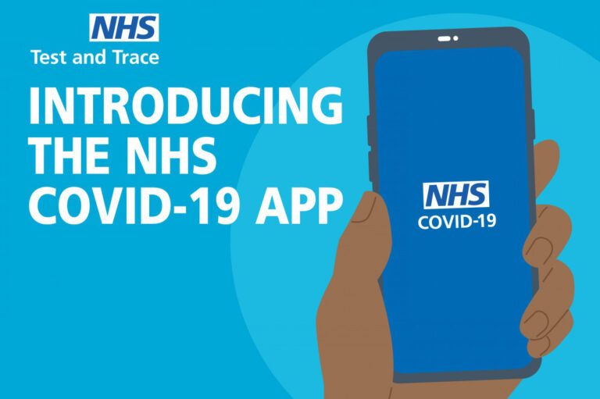

I’ve been contacted by NHS Test & Trace and have been told to self-isolate for 14 days.
START OF PRESENTATION

Slide 2
Why do I have to spend 14 days in self-isolation: it doesn’t make sense and seems unfair because I feel fine?

Slide 3

It’s because you have spent a sustained period of time somewhere, in a relatively closed environment with someone who has now tested positive. Sorry, but that’s why!

Slide 4
… but why 14 days: that seems far too long, I’m feeling fine and my family feel fine?

Slide 5
There’s a small chance you may have been infected. It can take as long as 7-10 days to incubate the virus and several more after that to be clear.

Slide 6
… but, like I said, I’m feeling fine – why can’t I just stay in school or go to work unless I start feeling ill?

Slide 7
If you have been infected, you won’t show symptoms until, maybe, 7 days have passed (possibly not at all); but you become contagious after only 2 or 3!

Slide 8
… so, I could have become infected, may feel fine for many days, but might still be infecting other people?

Slide 9
That’s right: if you are infected (day 1), you incubate the disease for a few days, then become contagious (around day 3), but symptoms show – if they show at all – even later than that.

Slide 10
I’m still not happy about the 14 days isolation: what if I get a test and come straight back to school or back to work if the result is negative?

Slide 11
Sorry, the test only works during the ‘symptoms’ phase, that is, after the virus is fully incubated: it’s no use before that 7 to 10 day period has passed.

Slide 12
So that’s why it’s still spreading: people catch it from contacts who don’t know they’ve got it … and don’t start feeling unwell until after they have spread it!

Slide 13
Absolutely: and the ‘spreader’ might never feel unwell, never get a test and never know.
If you have been a ‘close contact’, you really must self-isolate for 14 days.

Slide 14
What about the rest of my family?
Do they have to
self-isolate too?

Slide 15
If YOU are showing symptoms, then yes they must.
However, if you do not have any symptoms, other members of your family or support bubble DO NOT need to self-isolate.

Slide 16
Check out the NHS advice at the link below. (You can click the link) It will tell you everything you need to know if you are contacted by them.
https://www.nhs.uk/conditions/coronavirus-covid-19/testing-and-tracing/nhs-test-and-trace-if-youve-been-in-contact-with-a-person-who-has-coronavirus/
If you have any doubts about your symptoms or what to do for the best, contact the NHS 111 online coronavirus service or phone 111 if you can’t get help online.
Do NOT go to places like a GP surgery, hospital or pharmacy.
END OF PRESENTATION

