Slide 1
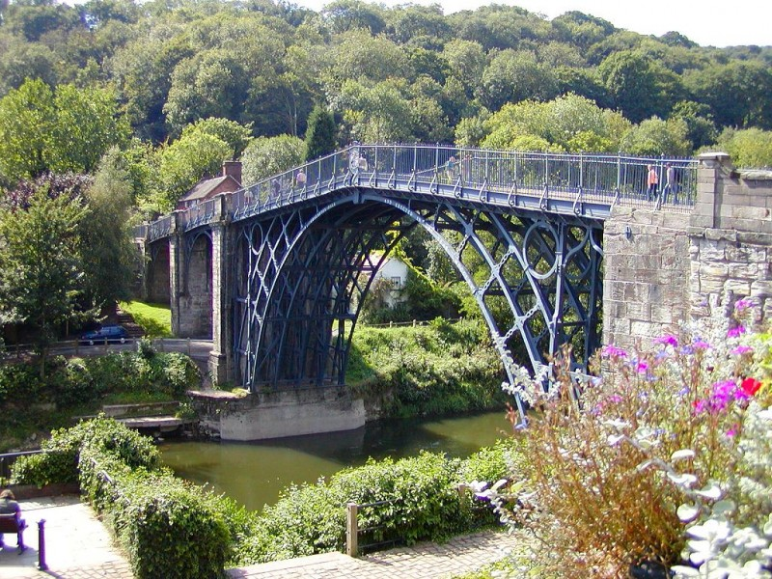
Ironbridge 2018

Slide 2
Dates
We leave on Monday 2nd July at 8am.
Suitcases can be brought into the hall from 7:00 am.
All children must arrive at school by 7:40am at the latest.
We will arrive back on Friday 6th July at approximately 6:00pm.
In the event of an excessive delay we will send a text message and it will be on Twitter.

Slide 3
Who is going?
Mrs Hepworth
Mr Zenklusen
Mrs Castle
Mrs Tong
Mrs Bristow
Mrs Brooks
Mrs Dyer
Mr Williams
Mrs Bissex

Slide 4
What can they bring?
The children can bring a camera if you want. They will be responsible for looking after it. The teachers will have digital cameras as well.
They do not need any other electrical equipment.
The children can bring pocket money if you want. We suggest a maximum £15 however you don’t need to give this much.
Where possible, pocket money should be given in coins rather than notes.

Slide 5
Clothing
The clothing list is in your pack.
Please try to name everything.
Be prepared for all weather!
You can never have too many pairs of pants and socks!
We will need wellies for Carding Mill Valley as we will be walking in the stream.
The children will also need a painting overall (old oversized shirt or t-shirt) for Jackfield Tile Museum.

Slide 6
Equipment
The children need to bring all of their belongings in a suitcase. Unlike Fairthorne, they do not need bedding.
The will need a ruck sack to use as a day bag (not too big).
The children will need a packed lunch on the first day. This must be in their day bag and not their luggage.
A pencil case with basic supplies.

Slide 7
Medical Forms and medicines
You will receive a medical form in your pack tonight. This needs to be returned to school no later than Friday 8th June.
As with Fairthorne, if your child needs to take medicine it must be labelled with clear instructions. This includes travel sickness tablets (before arriving at school).
All medicine must be given to the group leader on Monday morning (small container).

Slide 8
Photos
During our visit, we would like to keep you posted of all our wonderful experiences. Herne has a Twitter page, which could be used to upload photos of the activities. If you would not like your child photographed for this purpose, please could you let the office know in writing to admin@hernejunior.com

Slide 9
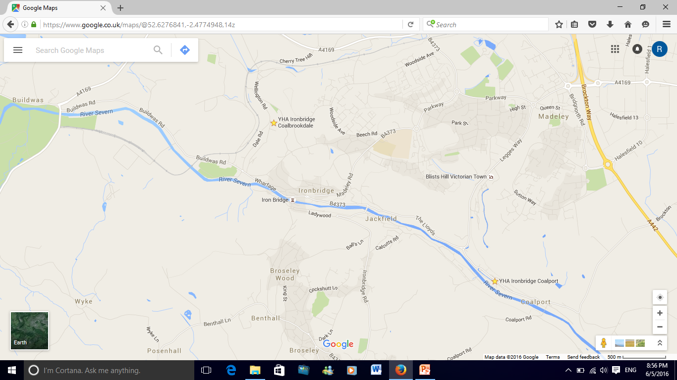
Where are we staying?
We will be staying in 2 different hostels in the Ironbridge area – Coalport and Coalbrookdale.

Slide 10
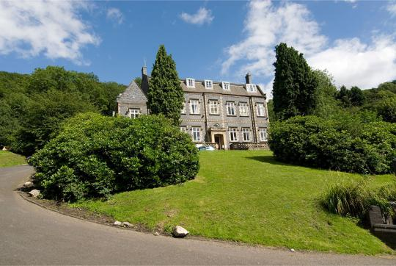
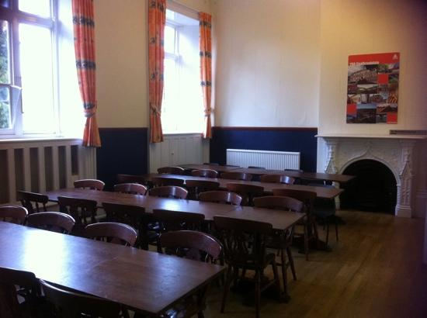
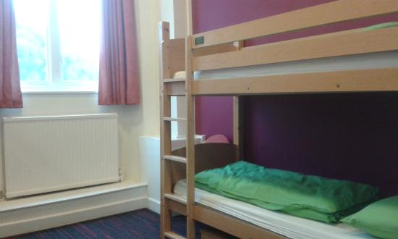
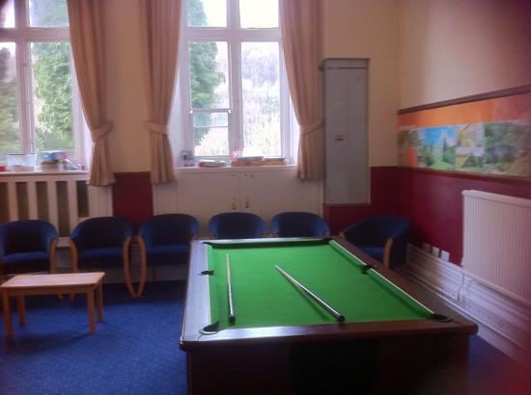
Coalbrookdale

Slide 11
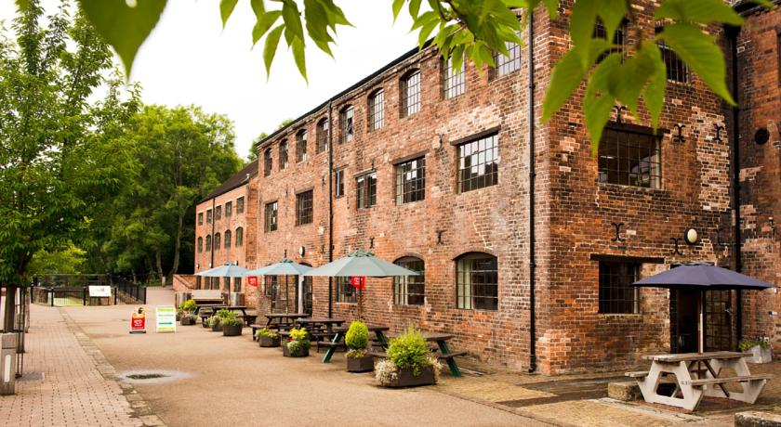
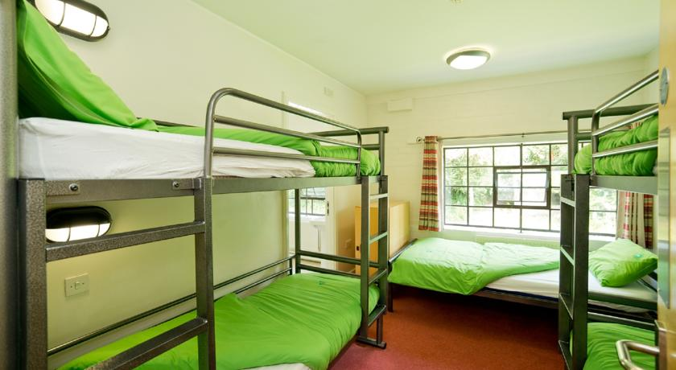
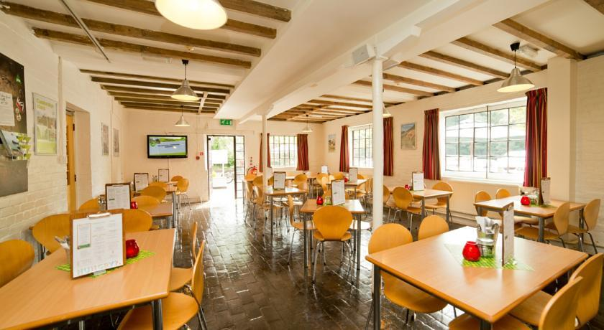
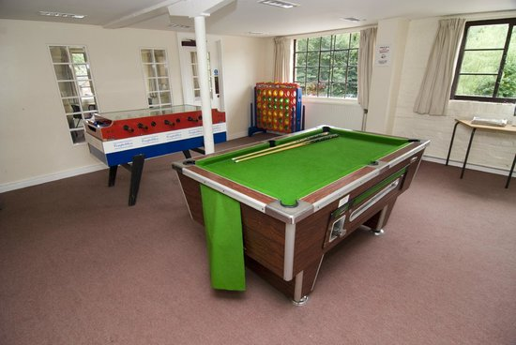
Coalport

Slide 12
Where will we be visiting?
Monday – Black Country Living Museum
Tuesday and Wednesday – Cardingmill Valley, Jackfield Tile Museum, Wightwick Manor and Enginuity.
Thursday – Blists Hill
Friday – Cadbury World

Slide 13
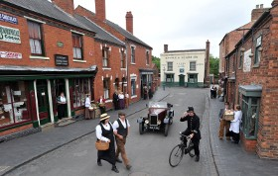
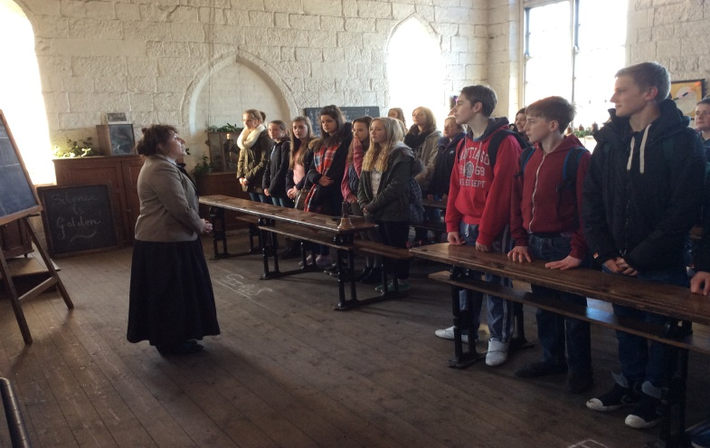
Black Country Living Museum
We will take part in the school experience and go down into the mine.
Each group will follow the trail and story of a Victorian child.
There are a variety of shops, and industrial buildings.

Slide 14
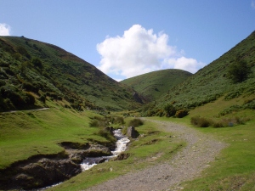
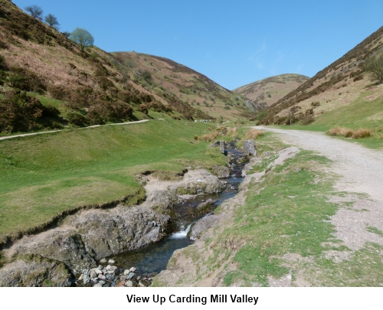
Carding Mill Valley
Here we undertake a small river study.
This supports our river topic from the Autumn term.

Slide 15
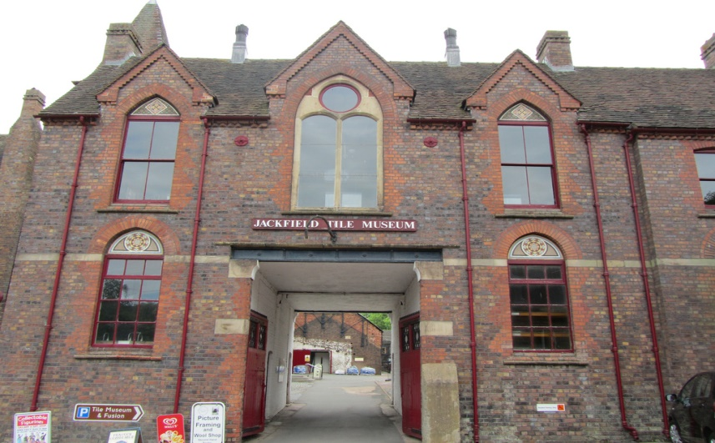
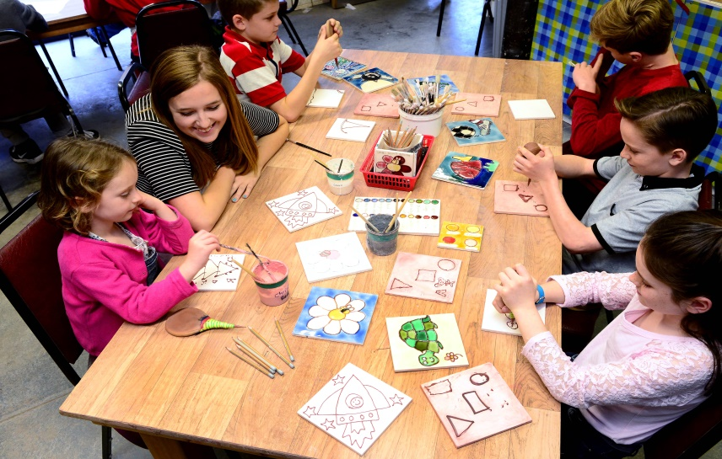
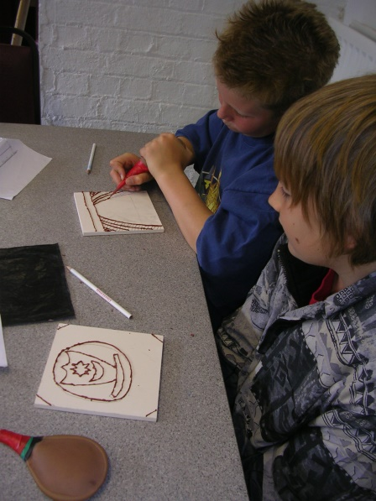
Jackfield Tile Museum
The children will design and make their own tile.
Once they have finished they will look at the Victorian designs in the museum.

Slide 16
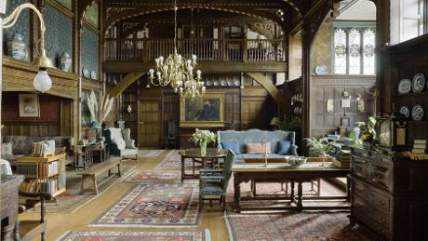
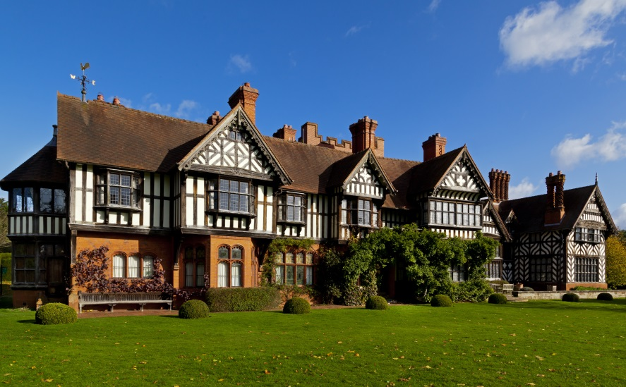
Wightwick Manor
Wightwick Manor allows the children to see another side to Victorian life.
The children take a tour around the National Trust site.

Slide 17
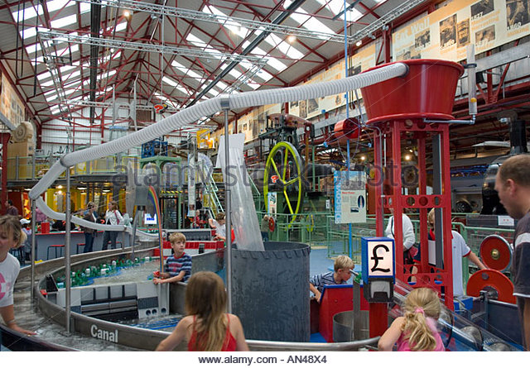
Enginuity
Links to our science curriculum.
Hands-on, interactive displays, models and investigations.
Extended due to popularity!

Slide 18
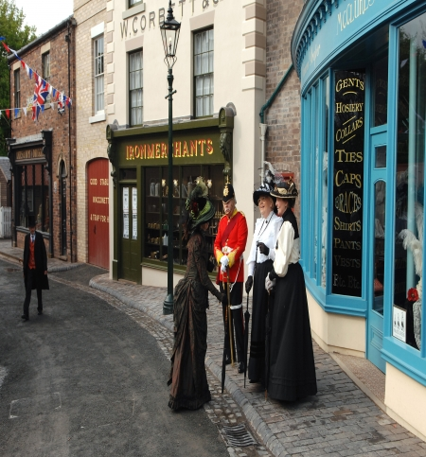
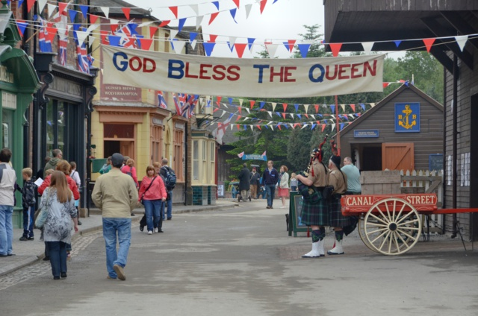
Blists Hill
The children will be fully immersed in Victorian life.
Visiting the museum is like stepping back into the Victorian era.
They can change their money to shillings; visit the baker, candle maker or printer; and sing along with the piano player in the pub.

Slide 19

Cadbury World
The children will take part in the museum tour.
This will support our spring Mayan topic.
Includes a 4D cinema trip.

Slide 20
Groups
The groups are being sorted out.
They will have both a day and night group which they will find out much closer to the time.
The children have had input into who they want to be with.

Slide 21
School Insurance
In the past, parents have received the certificate summary in the pack however Hampshire no longer produce this.
This year if you want to see the certificate then you can request a copy from the school office.

Slide 22
Any Questions?

