Slide 1
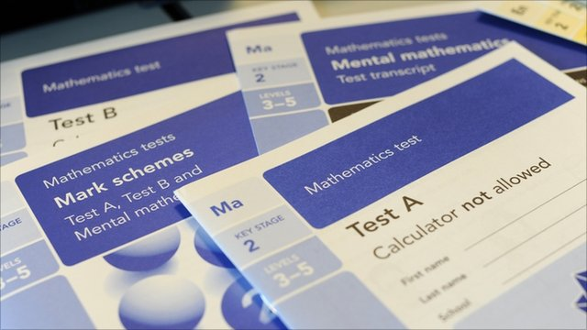

The 2018 SATs tests
&
How to support your child at home

Slide 2
Our vision for the tests
Our priority is always the happiness of your children and we want them to think of the week as any other week.
We want the children to be as calm as possible which is why we practise the tests.
Regrettably, the tests are possibly more important than ever before.
The Government are putting more emphasis then ever on the tests both for the school and the children.
The children have also been working extremely hard and we want them to have a sense of pride when
they receive their results.

Slide 3
The changes
In the summer term of 2016, children in Year 2 and Year 6 took the first new SATs papers. These tests in English and Maths reflected the new national curriculum, and were intended to be more rigorous. There was also a completely new marking scheme to replace the existing national curriculum levels.
These tests are set and marked externally, and the results will be used to measure the school’s performance (for example, through reporting to Ofsted and published league tables). Your child’s marks will be used in conjunction with teacher assessment to give a broader picture of their attainment.
The children are expected to reach the expected standard – ‘secondary ready’. It has been suggested that if the children do not make the expected standard then they will have to re-do parts of
the year 6 curriculum and possibly re-sit the tests.

Slide 4
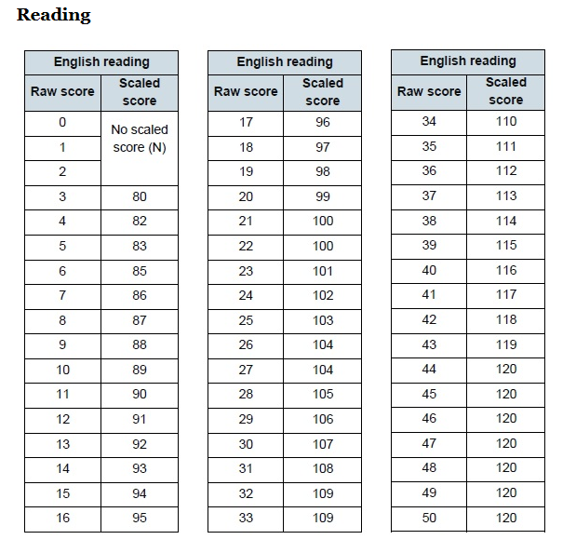
The changes

Slide 5
The changes
The children will sit tests in Reading, Maths and Spelling, Punctuation and Grammar (SPAG).
The mental maths test has gone and has been replaced with an arithmetic paper.
They will now sit 2 maths reasoning papers which replace the old paper A and paper B.
Reading and SPAG remain the same.
Writing will continue to be teacher assessed.
For all the tests, the expected standard is significantly higher than previous years.

Slide 6
The timetable
All the tests will take place in the week commencing 14th May.
Monday 14th – SPAG: Punctuation & Grammar (45mins) and Spelling (Approx. 20mins)
Tuesday 15th –Reading (1 hour)
Wednesday 16th – Arithmetic (30mins) and Reasoning 1 (40mins)
Thursday 17th – Reasoning 2 (40mins)

Slide 7
The set-up
Most of the children will sit the test in their classroom.
Some will sit the test in the hall or in other rooms.
This will be based upon what is best for the individual child.
A small number of children will have a reader for the SPAG and Maths papers.
In order to have a reader, the child’s reading age has to be at least 2 years below their actual age.
All other children can have questions read to
them but they must ask for the help (excluding Reading paper).

Slide 8
The reading test
The reading test will be a single paper with questions based on three passages of text. Your child will have one hour, including reading time, to complete the test. There will be a selection of question types, including:
Ranking/ordering, e.g. ‘Number the events below to show the order in which they happen in the story’
Labelling, e.g. ‘Label the text to show the title of the story’
Find and copy, e.g. ‘Find and copy one word that suggests what the weather is like in the story’
Short constructed response, e.g. ‘What does the bear eat?’
Open-ended response, e.g. ‘Look at the sentence that begins
Once upon a time. How does the writer increase the tension throughout this paragraph?
Explain fully, referring to the text in your answer.’

Slide 9
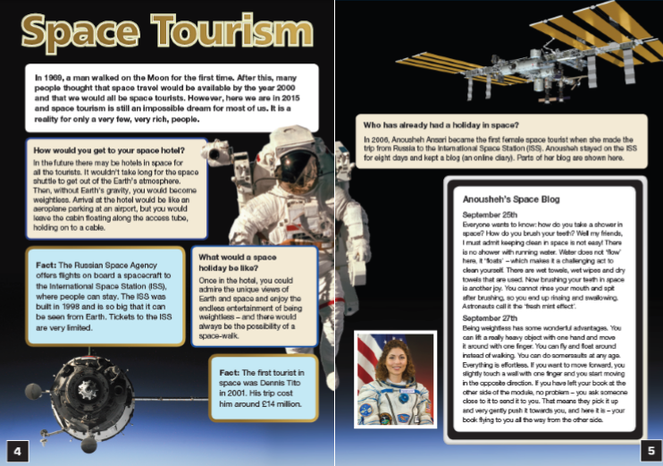
Sample reading paper

Slide 10
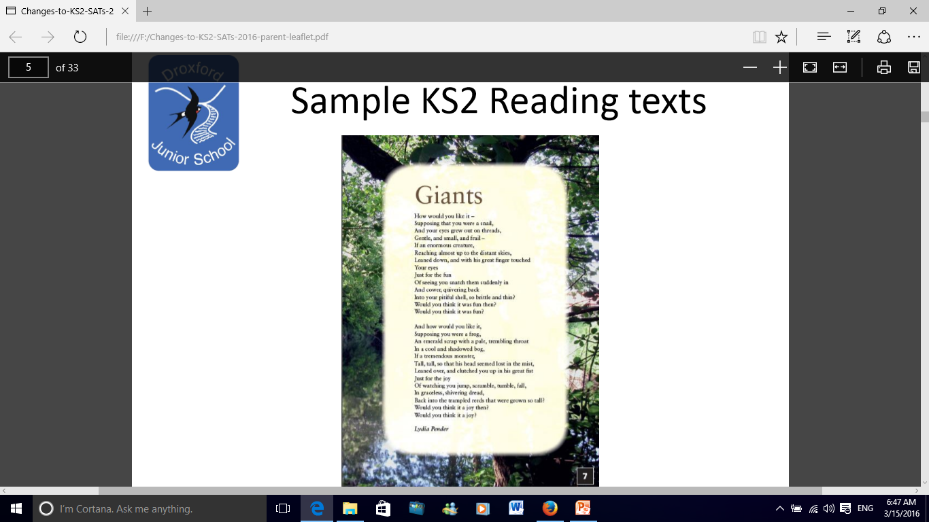
Sample reading paper

Slide 11
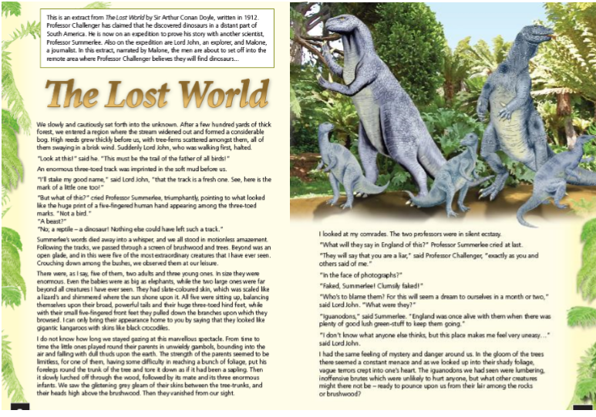
Sample reading paper

Slide 12
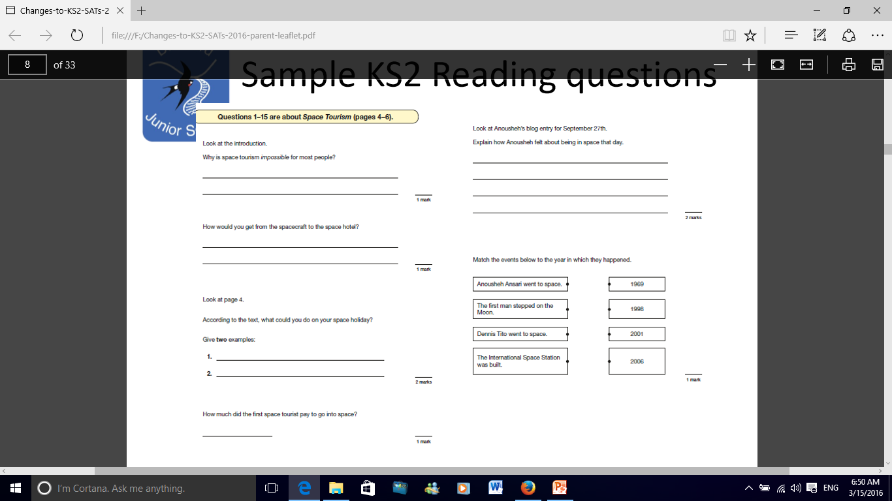
Sample reading paper

Slide 13
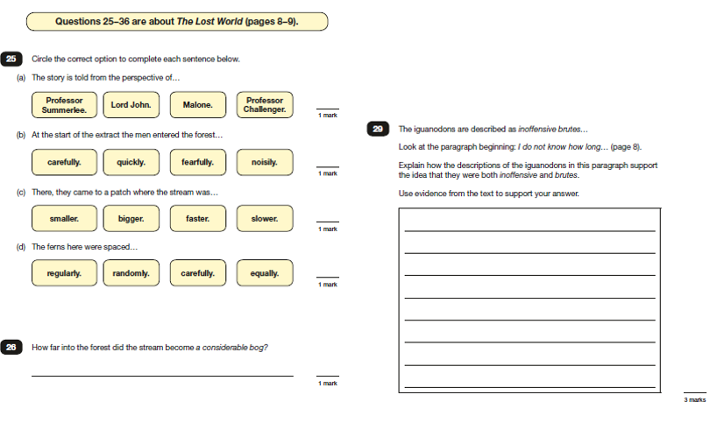
Sample reading paper

Slide 14
The grammar, punctuation and spelling tests (SPAG)
The grammar, punctuation and spelling test will consist of two parts: a grammar and punctuation paper requiring short answers, lasting 45 minutes, and an aural spelling test of 20 words, lasting around 20 minutes.
The grammar and punctuation test will include two sub-types of questions:
Selected response, e.g. ‘Identify the adjectives in the sentence below’
Constructed response, e.g. ‘Correct/complete/rewrite the sentence below,’ or, ‘The sentence below has an apostrophe missing. Explain why it needs an apostrophe.’

Slide 15
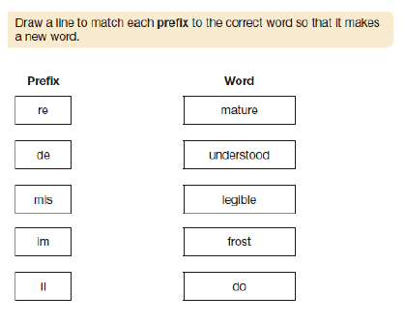
Sample grammar paper

Slide 16
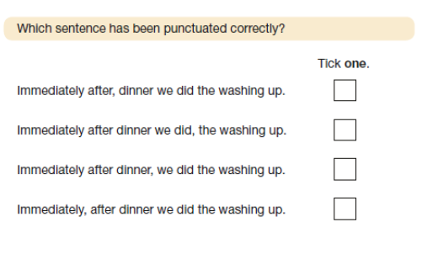
Sample grammar paper

Slide 17
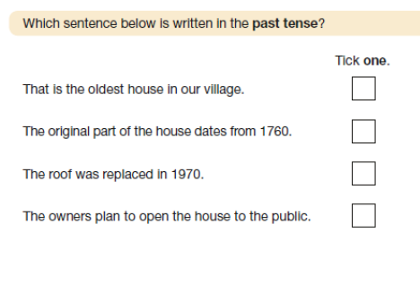
Sample grammar paper

Slide 18
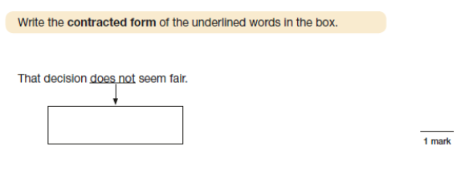
Sample grammar paper

Slide 19
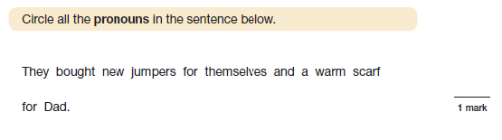
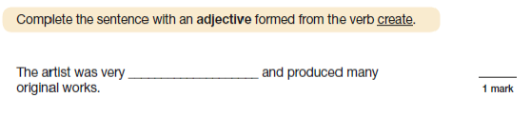
Sample grammar paper

Slide 20
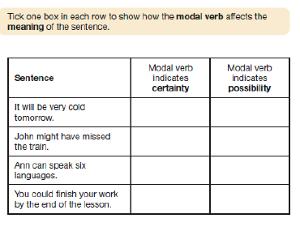
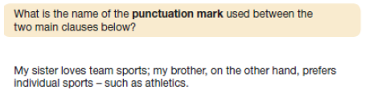
Sample grammar paper

Slide 21
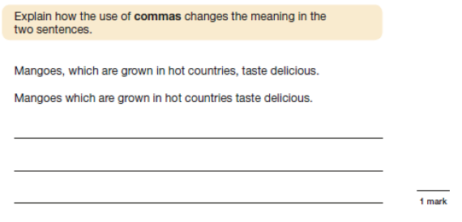
Sample grammar paper

Slide 22
How to support your child with SPAG: Spelling, Punctuation And Grammar
Help your child learn the spellings that are sent home.
When reading to and/or with your child discuss the use of inverted commas to mark speech, the use of parenthesis (brackets) to add additional information, the use of capital letters etc.
Revision books. Unfortunately, the grammar paper relies on a child knowing the terminology e.g. subordinate clause, main clause, adjective, article, passive, active – and many more. We use these in daily teaching practice however, for additional support at home, we are selling a revision book for a low price.

Slide 23
The maths papers
Paper 1 (Arithmetic) will consist of fixed response questions, where children have to give the correct answer to calculations, including long multiplication and division. Papers 2 and 3 (Reasoning) will involve a number of question types, including:
Multiple choice
True or false
Constrained questions, e.g. giving the answer to a calculation, drawing a shape or completing a table or chart
Less constrained questions, where children will have to explain their approach for solving a problem

Slide 24
Sample KS2 maths arithmetic questions
3
4
7
8
+
95% of 240
17 × 1
1
2
234,897 - 45,996
1,440 ÷ 12
20 − 4 × 2 =
4²
15.4 − 8.88
1.52 × 6
48 ÷ 6

Slide 25
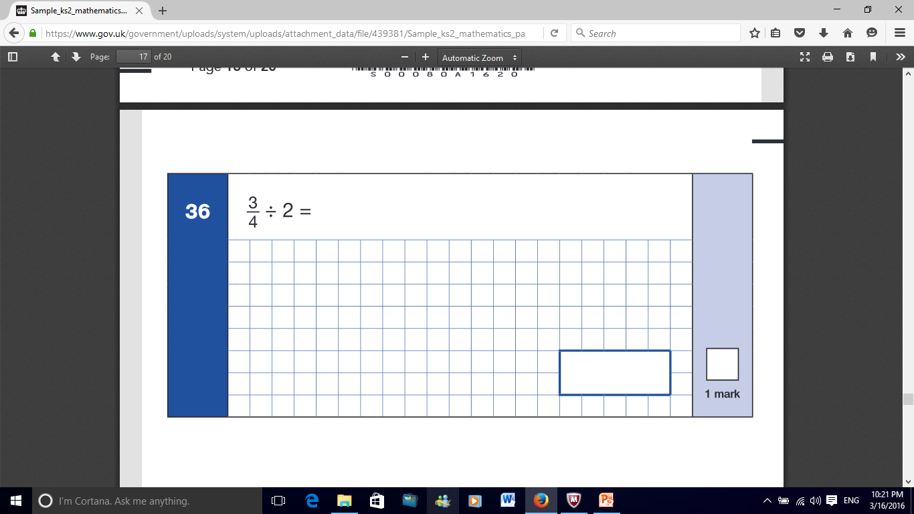
Sample KS2 maths arithmetic questions

Slide 26
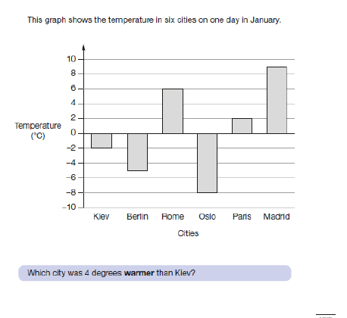
Sample KS2 maths reasoning questions

Slide 27
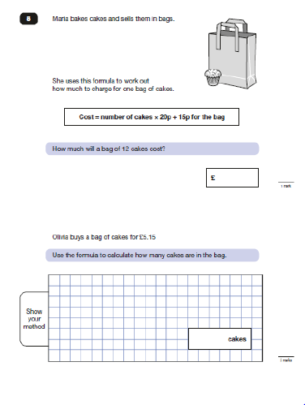
Sample KS2 maths reasoning questions

Slide 28
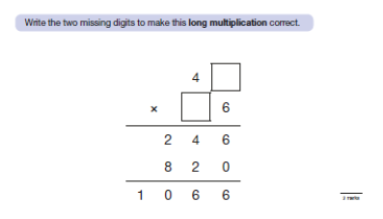
Sample KS2 maths reasoning questions

Slide 29
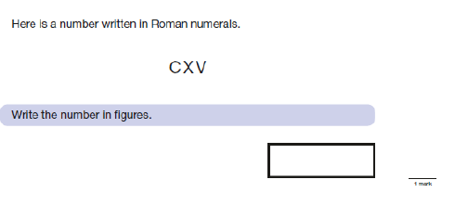
Sample KS2 maths reasoning questions

Slide 30
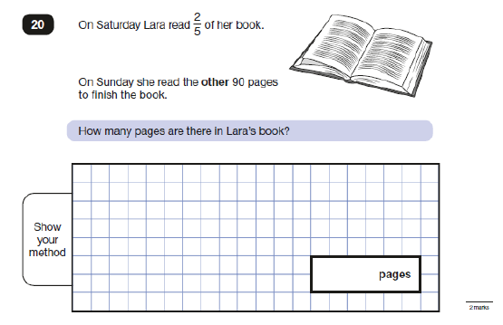
Sample KS2 maths reasoning questions

Slide 31
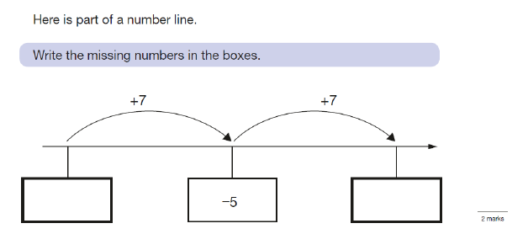
Sample KS2 maths reasoning questions

Slide 32
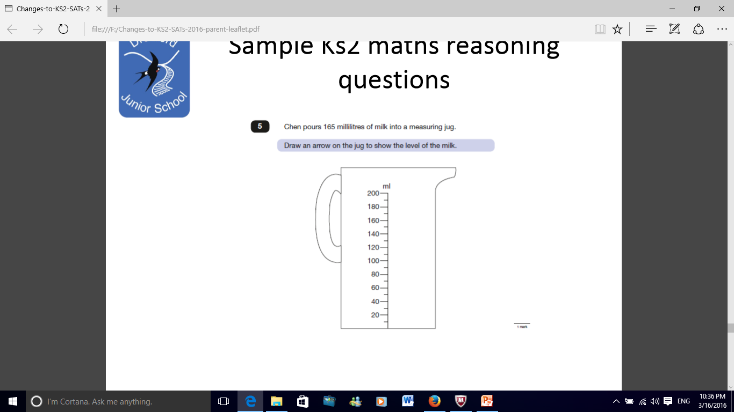
Sample KS2 maths reasoning questions

Slide 33
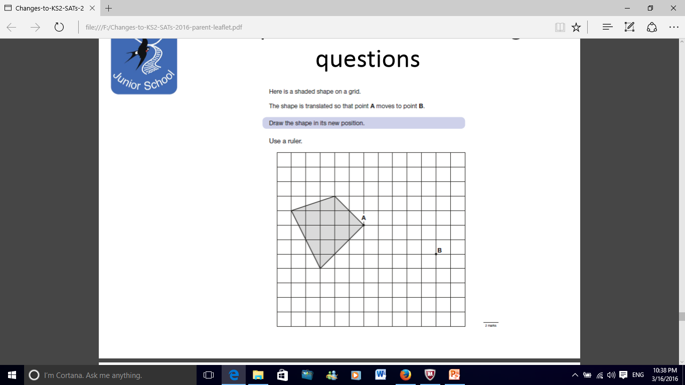
Sample KS2 maths reasoning questions

Slide 34
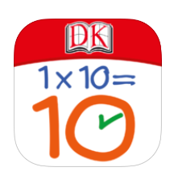
How to support your child with maths
Help your child to learn and secure their times tables. We recommend the Dorling Kindersley 10 minutes a day app.
Practise the formal written methods.
Ask your child time questions such as what time was it ½ an hour ago?

Slide 35
General Top Tips
Top tip 1 – Keep supporting your children with their homework and daily reading.
Top tip 2 – Encourage your child to work at speed. Try timed recall of times table facts. Set 1 minute challenges – ‘You have 1 minute to find the word on the page that means dangerous.’ ‘What is 10% of 150? You have 10 seconds.’
Top tip 3 – Make sure that your child realises that getting stuck is not a problem – encourage them to move on and then come back.
Top tip 4 - Encourage your child to believe in themselves.

Slide 36
The obvious stuff
Make sure that your child gets plenty of sleep.
Ensure that they have a good breakfast.
Keep them relaxed in the evenings.
They can bring in a lucky charm or mascot.

Slide 37


Revision
SPAG Revision Guides
Information as well as questions!
£2.50

Slide 38

Questions

