Slide 1
Welcome to year 6

Slide 2
Meet the Year 6 Team…
Damson - Mrs Armitage, Mrs Arnold and Mrs Crockford
Willow - Mrs Elliot-Smith and Mr Hurst
Mimosa - Mrs Gordon and Mrs Anderson
Quince - Mrs Marlow and Mrs Van de Merwe

Slide 3
UNIFORM
Jewellery should only consist of a watch and/or one pair of stud earrings
No make up or nail polish
Appropriate black school shoes (not trainers)
Black or grey socks for boys…black, grey or white for girls (black or grey tights)
PE kits need to be worn on Tuesday and Wednesday
Please ensure long hair is tied back
Remove earrings or please cover with micro-pore tape
Plain black tracksuit bottoms or non-lycra shorts (no Nike Pro style shorts please), green t-shirt, plain black hoodie or jumper (or school jumper please)

Slide 4
Belongings/equipment
Smart phones are no longer allowed in school. If your child needs a non-smart phone for walking home from school, please fill out a form from the school office. Phones will need to be handed to the office daily.
Please ensure your child has a dictionary and/or a thesaurus (these will be used daily and must be small enough to fit in a tray)
Pencil cases that are too large will be kept in school bags or pigeon holes
All children should have a water bottle with them at all times
Do encourage to bring a waterproof as we will always try to get children outside, even in light drizzle
Healthy snacks are encouraged and your child must place this in the classroom’s Healthy Snack Box (not taken from their lunch box)

Slide 5
PPA – Wednesday morning
Forest School (Woodland Wonders)
Lead by Mrs Hepworth and Miss Gore. You will receive a letter prior to your child’s class starting informing you of further details. Willow class is the first class, followed by Quince, Mimosa and Damson.
OR
Physical Education
Taught by CM Sports coaches
Covers Games and Athletics
French
Taught by Mrs Lee
SPaG
Taught by Mrs Clack

Slide 6
Reading
It is really important to develop reading stamina. Our expectation is, as in previous years, that the children read for at least 10 minutes every evening. We ask the children to complete the comments section with a quick summary of what they have read that day.
We encourage pupils to read challenging texts of both fiction and non-fiction and vary genres/authors.
Library and link books can be changed every day after school. Our library day is Thursday.

Slide 7
Themes in Year 6
Rivers and Coasts - Physical Geography
Raiders of the Lost Maya - Ancient Civilizations
Revolutions - Local history study of the Victorian era

Slide 8
Science and DT
Animals and Humans - The Heart and Circulatory system
Electricity
Light
Living Things and their Habitats (taught in Forest School)
Inheritance and Evolution
Sewing – Christmas themed puppet
Food technology – Maya flatbreads
Motorised vehicle

Slide 9
ICT and PE
World Wide Web
PowerPoint vs Prezi
Excel
Green Screen
Coding
OAA
Dance
Gymnastics
Rounders

Slide 10
Personal , Social and Health Education (PSHE)
Identity
Health & Hygiene
Friendships and staying safe online
Careers
Relationship and Sex Education
In the summer term
Parents will be sent information regarding the material that will be shown in the summer term
Transition to my new school

Slide 11

Harmony values
This term respect-house points for demonstrating our value.
Move up board for other values.

Slide 12
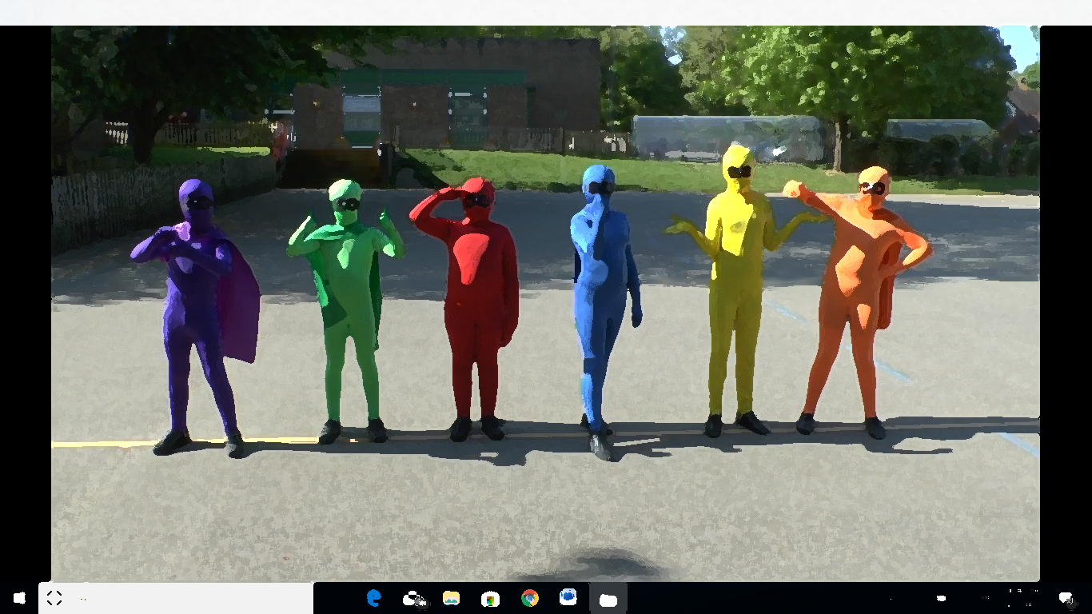
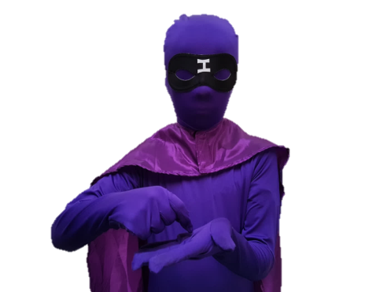
Independence
We encourage pupils to become more independent throughout this year, in preparation for their senior schools next year
It will help your child if they are encouraged to take on these responsibilities:
Pack their own bag the night before
Prepare their own lunches
Have their own equipment in school
Organise their own homework and timetables
Complete their homework independently (and seek help via their teachers or parents/carers as needed)

Slide 13

Homework
Homework books are handed out Friday and returned Friday
This will be self-marked and checked for its completion by an LSA or teacher
AT LEAST 6 maths questions answered plus a times table to practice
A reading comprehension task/research for future learning
Reading record books and times tables books to be handed in and checked EVERY DAY also
Reading (at least 5 times per week of 15 minutes, recorded in their home-link books)
6/7 reads per week to achieve the platinum reader level (including half-term)
Spellings – they need to make sure they are ready for a Friday test.
EXTENSION and further SUPPORT will be offered to pupils as necessary but please allow us time to gauge abilities (there are activities available on the website)

Slide 14
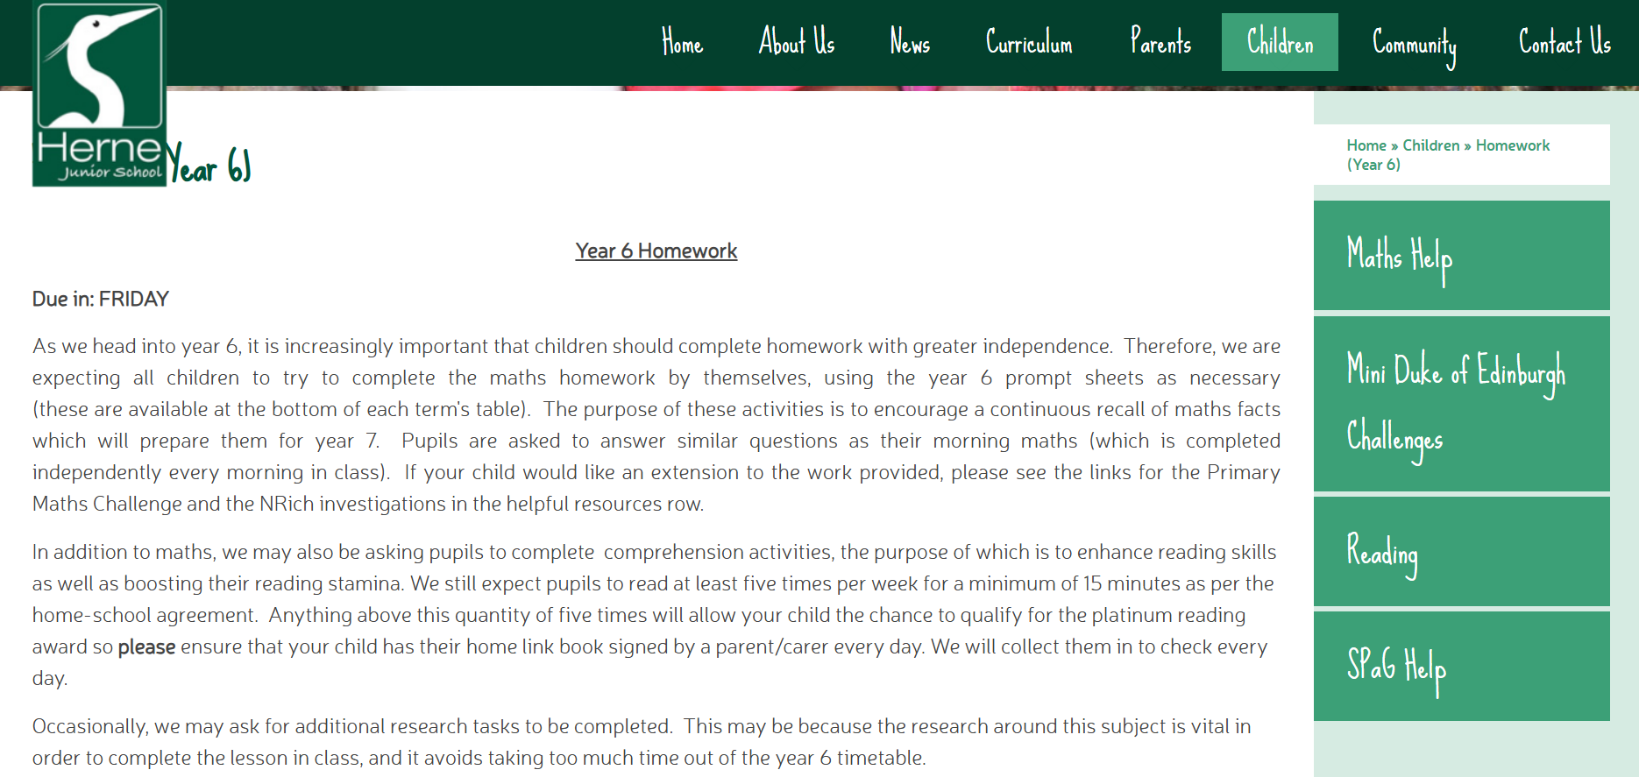
Homework support
Tabs have now been added to the Year 6 homework page for maths and SPaG guidance.
There is also a recommended reading list for year 6 pupils.

Slide 15
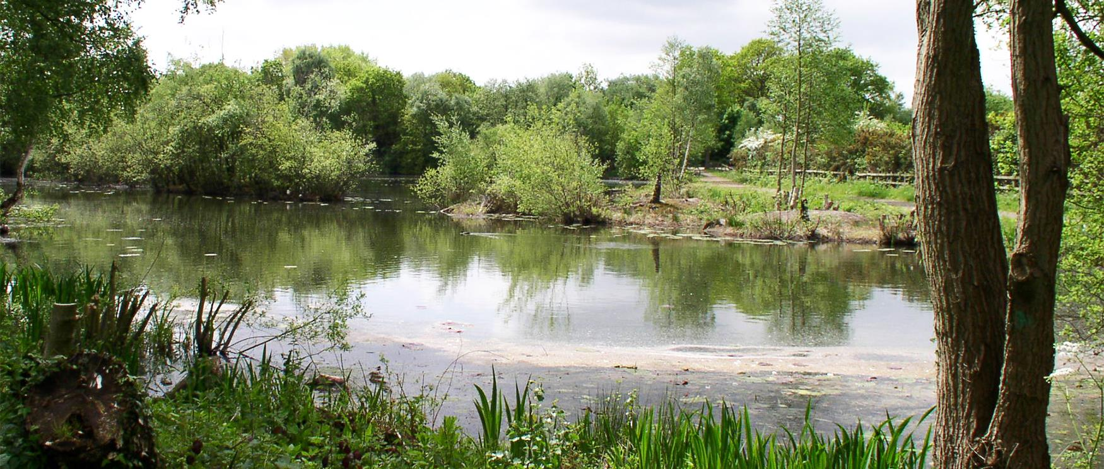
Dates
Selborne Field visit
Willow – Tuesday 23rd September
Damson– Wednesday 24th September
Quince– Monday 29th September
Mimosa – Tuesday 30th September
Parents’ evening
Thursday 9th October and Wednesday 15th October
SATS week
For the week commencing 12th May 2025
No holidays to be booked for this week please
Further information will be provided during the Spring Term to discuss these further and how we will support your child
IRONBRIDGE
A letter will be sent home with the details and price of this trip. There will be 2 groups:
Group 1: Sunday 21st June- Wednesday 24th June
Group 2: Wednesday 24th June- Saturday 27th June

Slide 16
Finally…
Please do join your class’ Whatsapp group where you can raise questions and clarify anything you are unsure of; our office are extremely overwhelmed and this would be really helpful ☺
Please email your child’s class teacher or Mrs Elliot-Smith (Year 6 Leader) if you have any concerns or queries regarding behaviour and safeguarding.
K.Elliot-Smith@hernejunior.com
C.Gordon@hernejunior.com
L.Marlow@hernejunior.com
M.Armitage@hernejunior.com
Remember we are promoting INDEPENDENCE this year so we would really encourage your child to use their voice.
We are very busy and cannot guarantee that we can respond to emails immediately; we will endeavour to do so within 48 hours.

