Slide 1
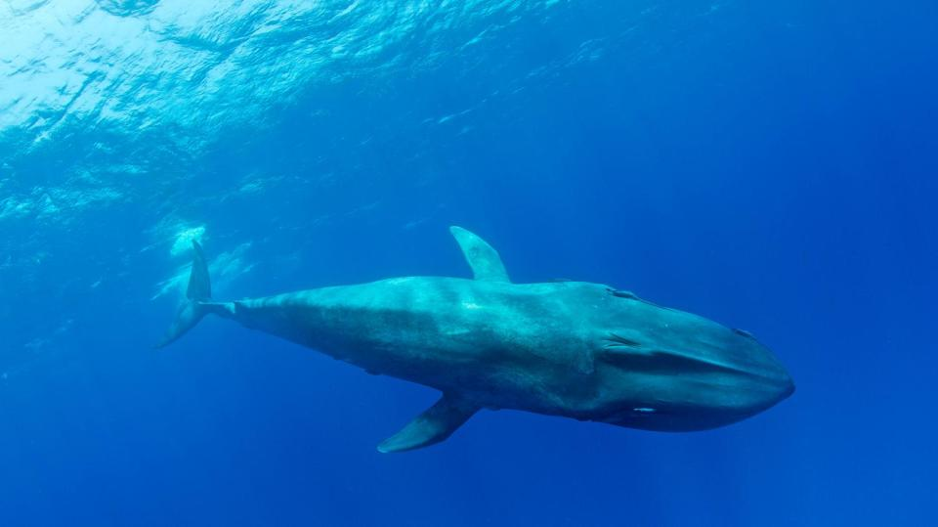
Our seas
Notes:
Covering about 70% of the earth’s surface, our seas supply half the oxygen we breathe and provide food and livelihoods for more than a billion people. They are also home to a wondrous array of wild species, from tiny plankton to the biggest creature that’s ever existed – the blue whale.

Slide 2
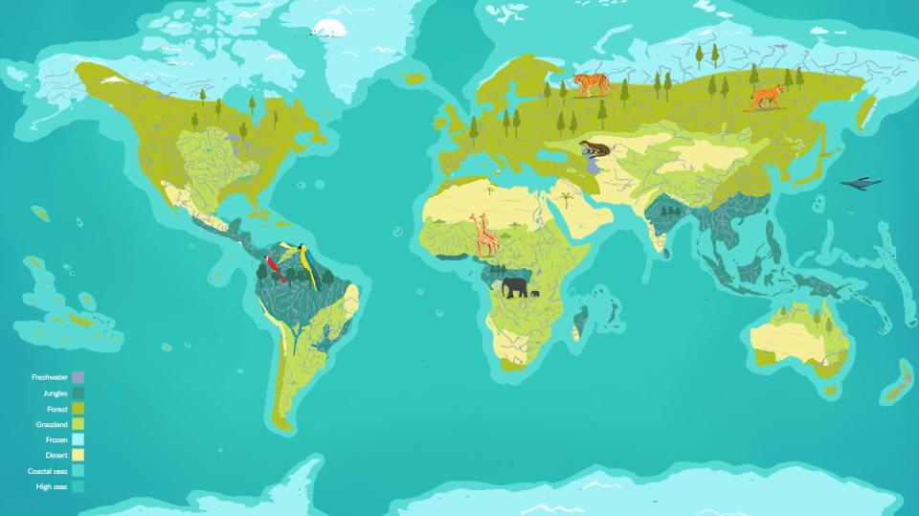
Arctic Ocean
Atlantic Ocean
Pacific Ocean
Pacific Ocean
Indian Ocean
Southern Ocean
Where in the world?
Notes:
Indicate coastal seas and high seas (oceans) on the world map.

Slide 3
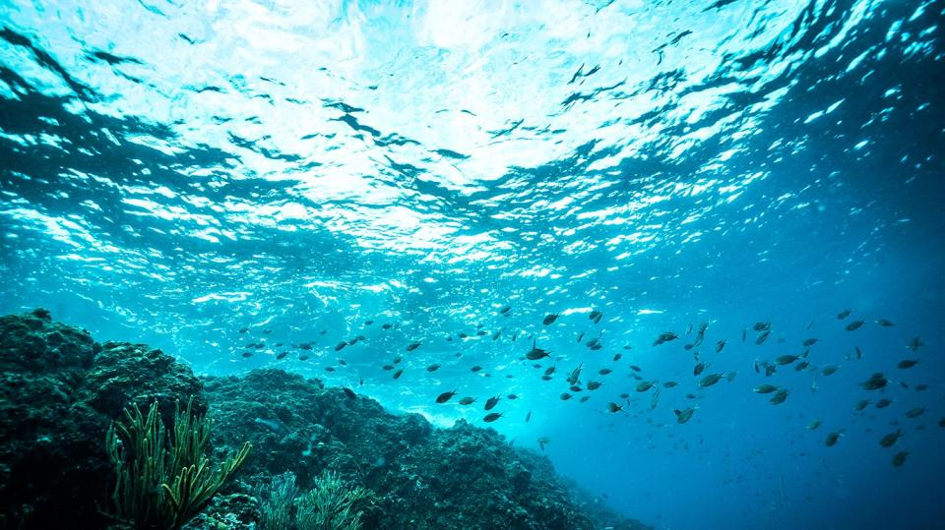
Let’s explore
our coastal seas
Notes:
Although they make up only 10% of the ocean, the shallow waters of coastal seas are home to 90% of all marine species. Here sunlight reaches the sea floor and plants can grow. These provide food for animals, protection from predators and a safe place for animals to breed and raise their young.
The coastal seas are made up of many different ecosystems including coral reefs, river estuaries, rock pools, salt marshes, mangrove forests and fields of underwater sea grasses.
Click to watch illustrative biome tour of our coastal seas: https://www.ourplanet.com/en/video/biome-tour-of-our-coastal-seas

Slide 4
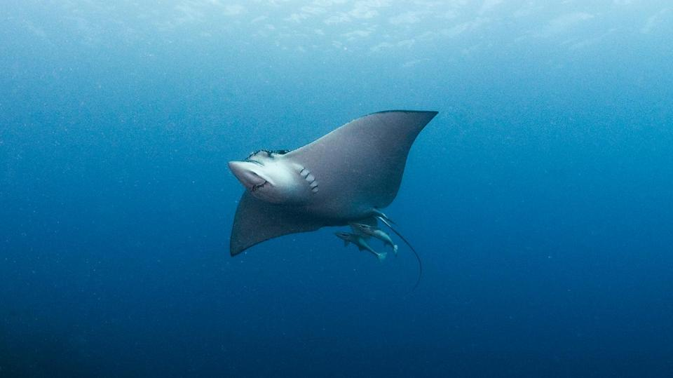
Let’s explore
our high seas
Notes:
Beyond the beaches and shallow coastal waters lie the high seas, which cover more
than 60% of our planet’s surface. This is by far the largest habitat on earth, but also one of the least understood.
Click to watch illustrative biome tour of our high seas: https://www.ourplanet.com/en/video/biome-tour-of-our-high-seas

Slide 5
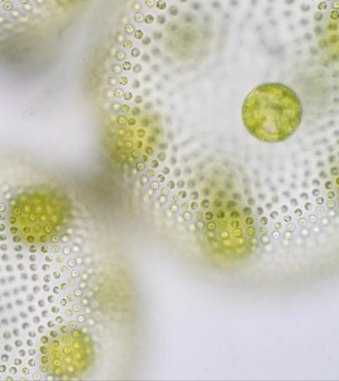
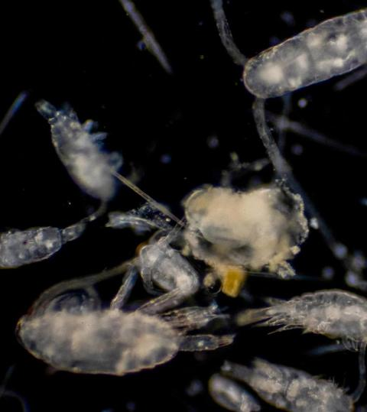
Phytoplankton
Zooplankton
Tiny life savers
Notes:
An expanse of seemingly empty ocean may contain much more life than it appears to the naked eye. Phytoplankton are microscopic floating algae which drift on the ocean currents and support the entire food chain of the open ocean. Phytoplankton are food for zooplankton (simple water-dwelling creatures), such as krill, which are the most numerous animals on earth. These in turn provide food for many sea creatures including the biggest animal that has ever lived on the planet – the blue whale.
Phytoplankton also produce half the oxygen in the air we breathe.

Slide 6
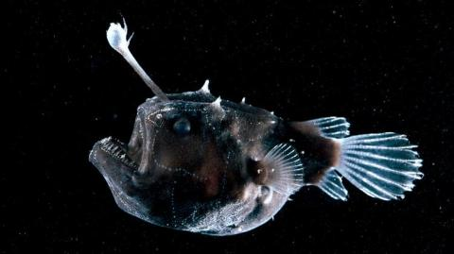
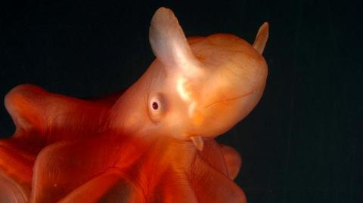
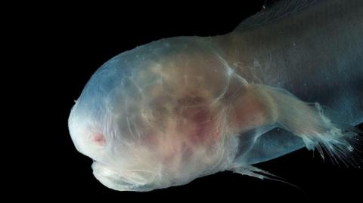
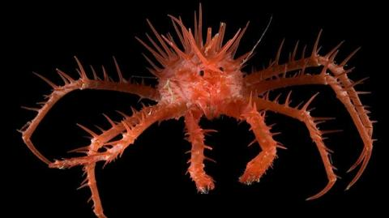
Anglerfish
Dumbo octopus
Gelatinous blindfish
Neolithodes
Mysterious depth
Notes:
Strange creatures live in the cold, dark depths of the ocean, adapted to the pressure and often creating their own light to lure prey.
Much deep-sea life depends on ‘marine snow’ - the remains of dead creatures and poop of living ones which drift down from the more populated surface waters.

Slide 7
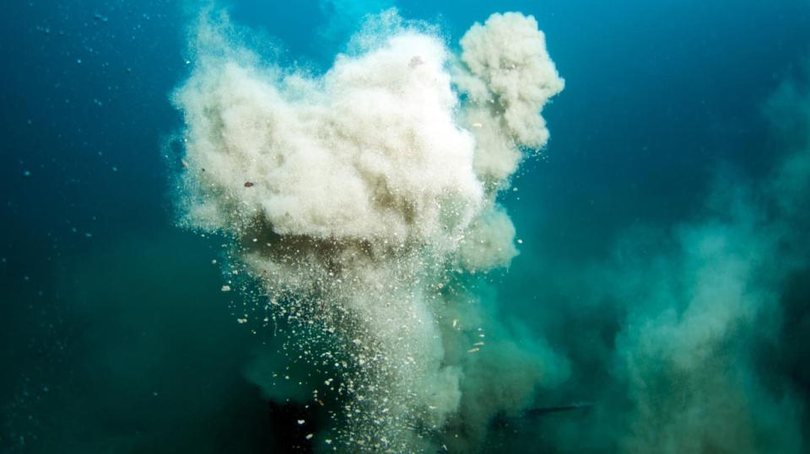
Image pending
Volcanic vents
Notes:
In the total darkness of the deep ocean floor, volcanic vents release super-hot, mineral rich water. A huge abundance of life thrives around these vents. Strange creatures survive here by feeding on bacteria, which get their energy from chemicals flowing from the vents.

Slide 8
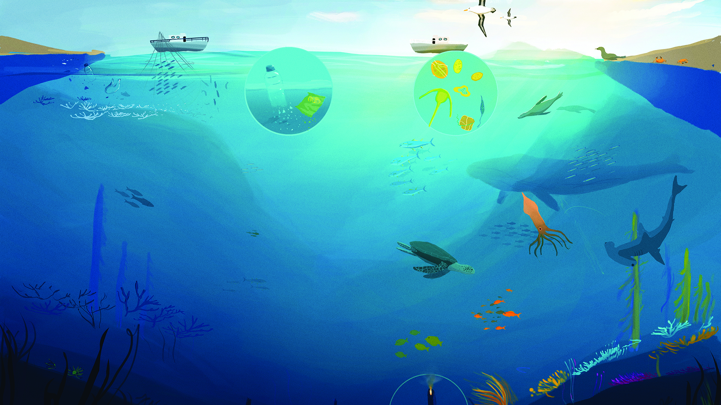
Warming
global temperatures make the seas more acidic, killing coral reefs on which many animals depend
for food and
shelter.
Overfishing prevents fish from building up numbers and drives species extinction.
More than
9 million tons of plastic waste makes its way into the sea each year, harming animals who mistake it for food.
What’s the problem?
Notes:
Despite the vastness of the oceans, human activity is devastating ocean ecosystems.
Overfishing
Whole fish populations are at risk of being wiped out because of illegal fishing and overfishing. Fishing provides the main income for over 200 million people, so it’s really important to protect coastal seas.
Plastic pollution
Every year, almost 9 million tons of plastic enter the ocean. That’s the same as a rubbish truck emptying its load every minute. In the middle of the Pacific, there is a huge area of plastic rubbish, twice the size of France. Plastic harms marine life.
Rising sea temperatures
Climate change is also harming ocean
life. As more carbon dioxide (CO2) is pumped into the air, more is taken up by the oceans, making them more acidic.

Slide 9
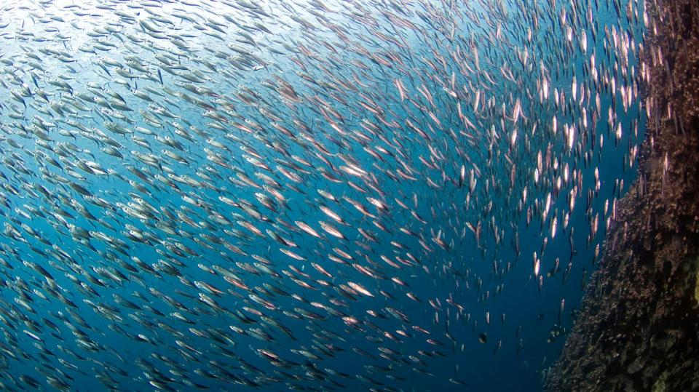
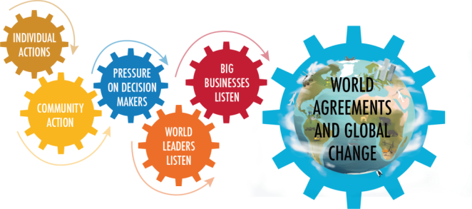
Global change
Create Marine Protected Areas in costal waters
Need for an international treaty to protect high seas from overfishing, mining and shipping
Individual actions
Buy sustainable fish and seafood
Reduce plastic use, reuse and recycle
Reduce use of fossil fuels that contribute to global warming
Hold businesses to account
Ask politicians to protect oceans
What can we do?
Notes:
We can all play a role in creating a more sustainable future through our own actions.
World agreement and global change
One way to protect the future of the oceans is for countries to create Marine Protected Areas (MPAs) in their coastal waters where fishing, mining or shipping are not allowed. This would provide safe spaces for fish stocks to recover and repopulate the oceans.
Less than 2% of the world’s international waters have any form of protection. To keep our oceans healthy, we need an international treaty to protect them for generations to come.

Slide 10
#OurPlanet
www.ourplanet.com
Notes:
Visit www.ourplanet.com for more information, classroom resources and a wealth of free videos.

