Slide 1
Year 4 Meet the Teachers
2025-26

Slide 2
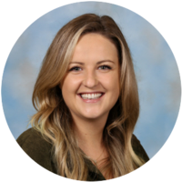
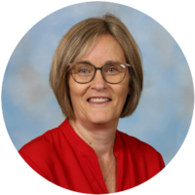
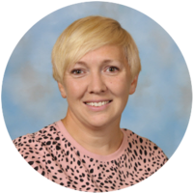
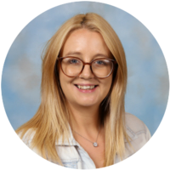
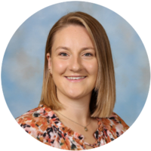
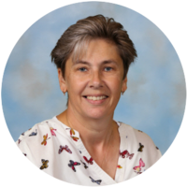
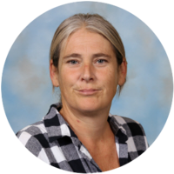
Year 4 Classes
Palm – Miss Podger (Year Leader)
Mrs Cooper (LSA)
Mrs Matthews (LSA Year Group support based in Palm Class)
Lime – Mrs Straffon
Mrs Chapman (LSA)
Plum – Miss Turner
Mrs Smith (LSA)
Pear – Miss Duncan
Miss Frampton (LSA)

Slide 3
PPA Tuesday Mornings
Games (P.E)
CM Sports Coaches
Spelling, Punctuation and Grammar (SPaG)
Mrs Clack
French
Mrs Lee
Woodland Wonders (Previously Forest School)
Mrs Hepworth, Mrs Hall and Miss Gore + Class LSA support
Palm, Lime, Pear, Plum 9-10 week blocks across the year
More detail for your class timings will follow

Slide 4
PE - Tuesday and Thursday
Games (CM Sports) Tuesdays (when not on forest school rotation)
Indoor (gymnastics and dance) Thursdays with class teachers
Please come to school in PE kit on these days
Earrings must be removed and hair must be tied up if shoulder length or longer, please
Forest school clothes are to be worn during designated sessions, with named school uniform to change into (please see letter sent home prior to starting)

Slide 5
Curriculum
Themed approach to the curriculum so each of the topics will cover a number of subjects across the curriculum.
Saxons Vs Vikings
Grittleton Adventures Residential (1-st – 3rd October 2025)
Dress up day - Friday 7th November 2025
DT Day (Wooden Saxon House) – Thursday 4th December 2025
Imaginary Worlds (Pure Imagination) (dates to be confirmed)
DT Day (dates to be confirmed)
Special Visit from Open Box Theatre
Portal to the Past 1939-45 (World War 2) (dates to be confirmed)
Watercress Line
Dress up day
DT Day (Sewing bookmark)
Special Visit from Rainbow Theatre

Slide 6
Homework - Reading at home
Daily reading x5 per week minimum
Please sign home link books daily
Children don’t have to read their link book, but it is recommended at least 2x per week
The Link and library are open after school between 3.30-4.00pm
Please use the questions from inside the home-link book to support your child’s comprehension of what they are reading.

Slide 7
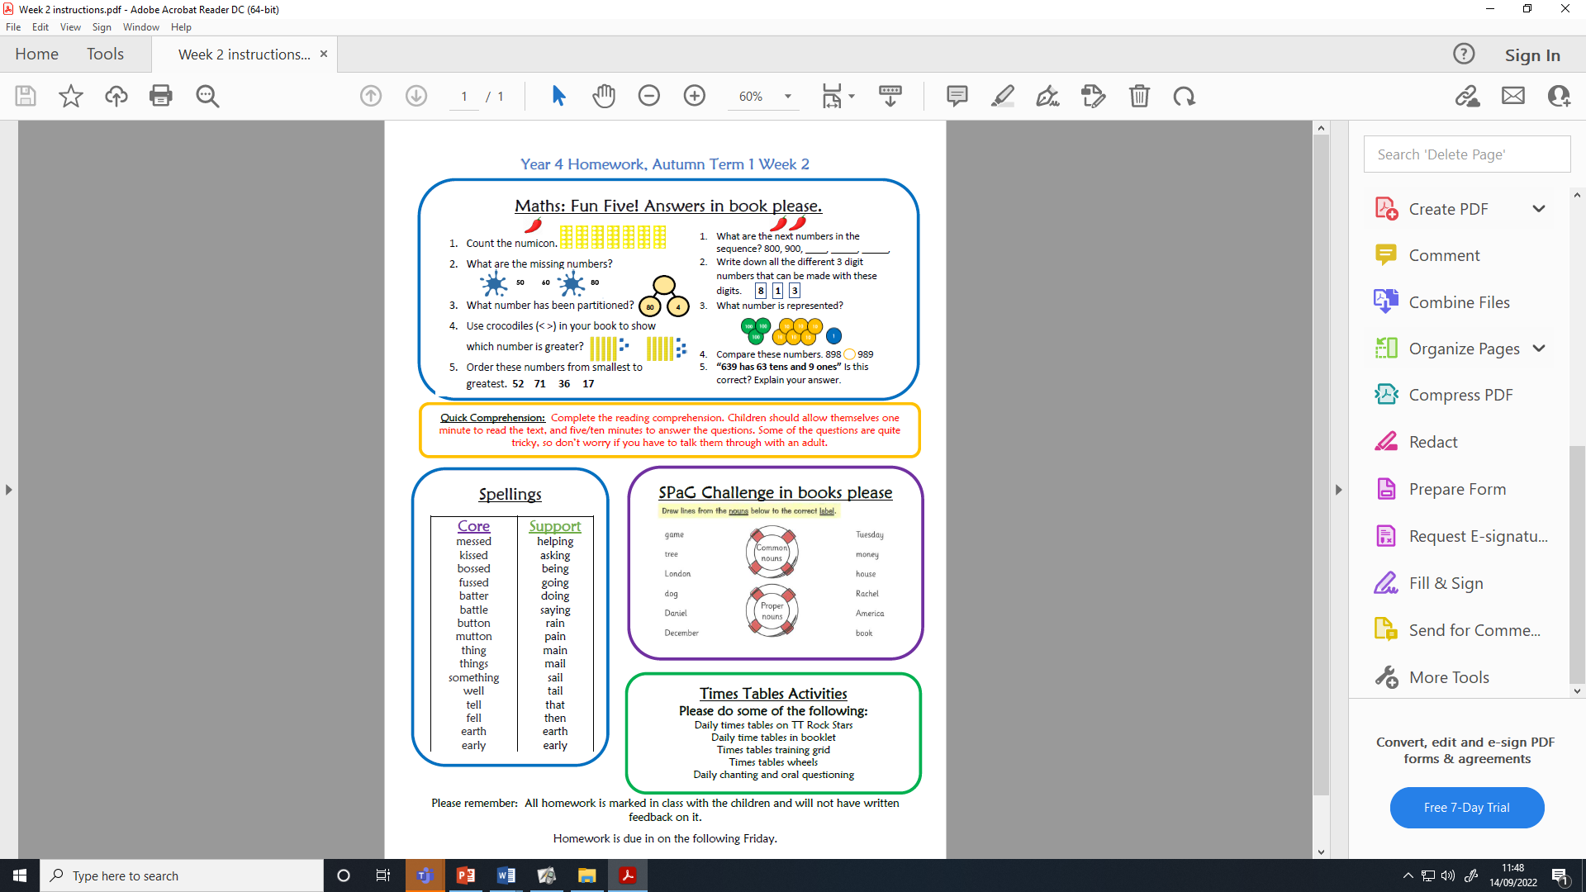
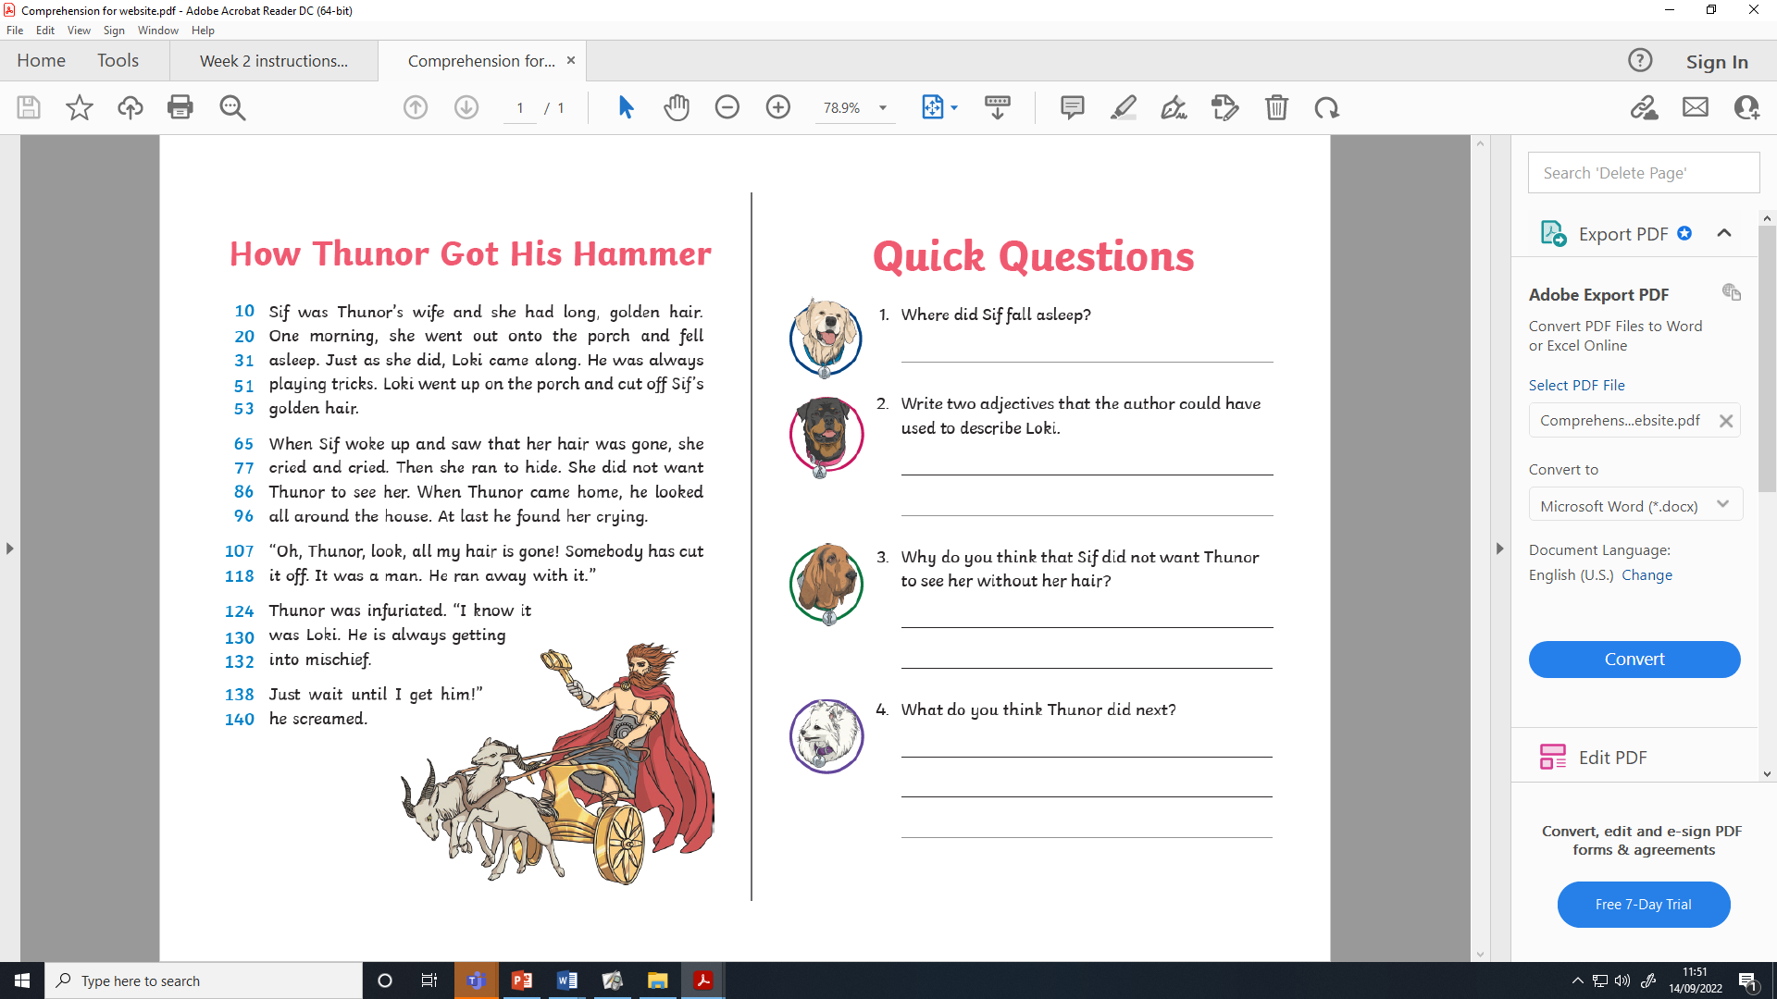
Homework
Homework sheets will be given to children on a Friday, to return to school the following Friday.
The task will be explained by class teachers
Children to complete answers neatly into green homework books
This is self-marked in class the following Friday
If your child is struggling with the homework, please bring it to the class teacher before Friday for in-class support.
Homework sheets are also available on the school website, should you be missing your sheet!
https://www.herne.hants.sch.uk/page/?title=Homework+%28Year+4%29&pid=131

Slide 8


Homework
Children will also be expected to complete weekly Spelling Shed and TT Rockstars tasks
Spellings rules will be set through Spelling Shed and children will be tested on these in class every other Friday
Any problems with logins, we will try to fix ASAP!

Slide 9
Times Tables Support
A Parent Workshop will be available in Autumn 2 will give Parents/Carers:
A Chance to play with different programmes
Learn strategies to support your child with Times Tables
More information regarding National Multiplication Tables Check (MTC)
Chance to ask questions
We will send out dates and times for this once they have been scheduled with the school diary.

Slide 10
Parents Evening
Thursday 9th October 2025
Wednesday 15th October 2025
Please keep an eye on the school flyer and emails for when the booking portal opens.
These are face-to-face meetings with Class Teachers
Children’s work will be showcased while you wait for your appointment time

Slide 11
Miscellaneous
Please remember we are a nut-free school and snacks brought in for break time must be a healthy option (fruit, cereal bar, crackers)
Please name all equipment and uniform, including water bottles and snack boxes, pencil cases etc so they can be returned if lost!
A Swimming Programme at the open air pool is organised for the Summer Term – details to come out closer to the time.

Slide 12
And Finally…
Please contact the admin team if you have any queries, they will pass on any emails to us if they can not directly answer them
Please keep an eye out for letters via email from the admin team for future dates and events. These will also be included on the School Flyer
Thank you!
Any questions…?

Slide 13

Thank You!
Do you have any questions?

