Slide 1
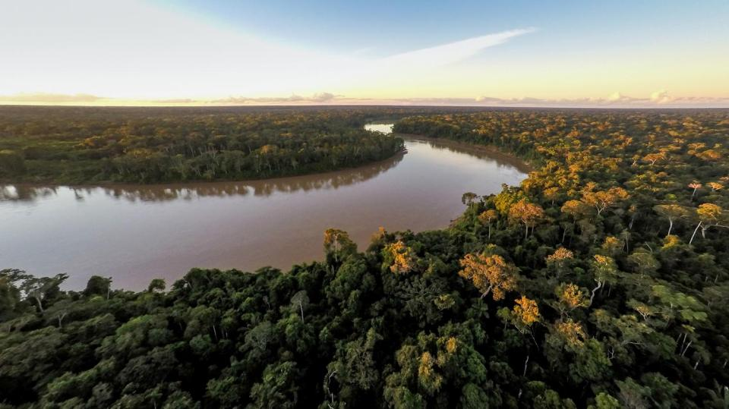
Our freshwater
Notes:
All life on earth depends on freshwater. Yet less than 3% of the water on our planet is freshwater. The rest is salty water in the oceans.
Almost all freshwater is locked up in ice caps or glaciers or buried deep underground. We are able to use less than 1% of freshwater as it flows through rivers and streams, ponds, lakes and wetlands.

Slide 2
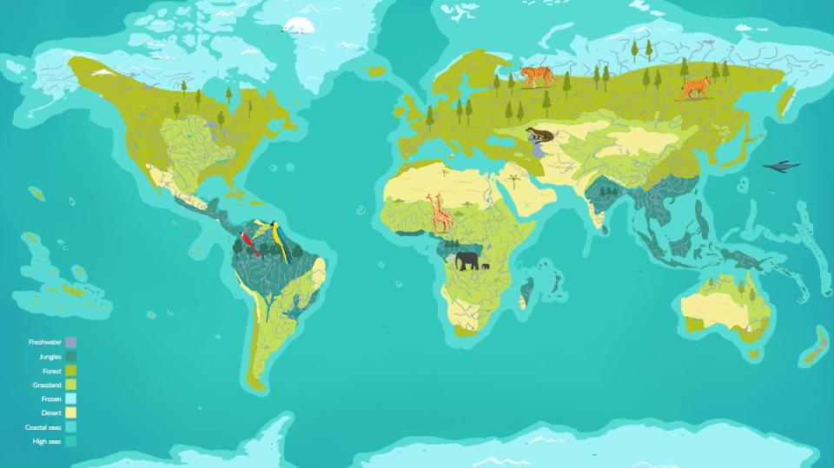
Where in the world?
Notes:
Indicate main rivers and lakes on the world map.

Slide 3
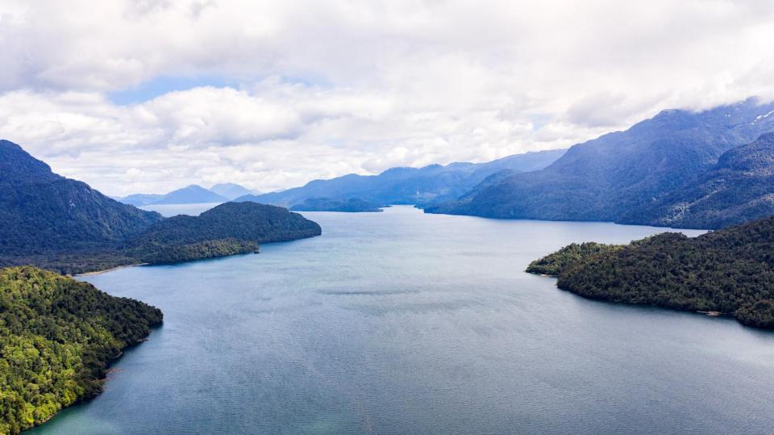
Placeholder for film
Let’s explore
our rivers and lakes
Notes:
Let’s have a look at our freshwater ecosystems.
Click to watch illustrative biome tour of our freshwater: https://www.ourplanet.com/en/video/biome-tour-of-our-freshwater/

Slide 4
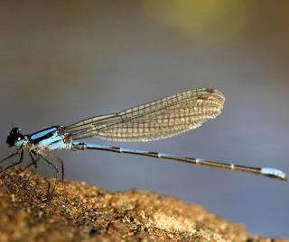
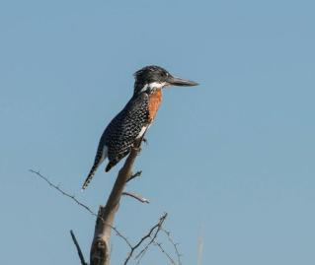
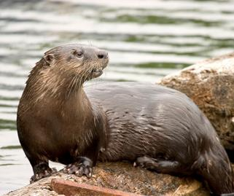
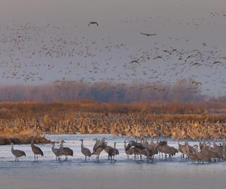
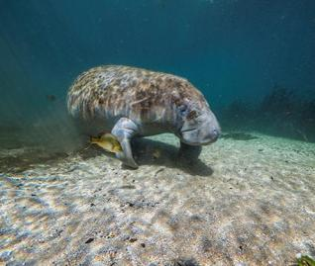
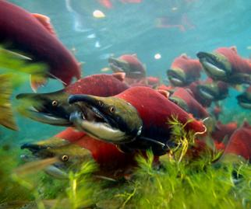
Dragonfly
Kingfisher
Otter
Sandhill cranes
Florida manatee
Pacific salmon
Water for wildlife
Notes:
Freshwater habitats are home to more than 10% of all known animals and almost half of all known fish species.
Freshwater ecosystems allow wildlife to travel vast distances to complete their life cycles. They also transport nutrients which make soil good for growing food.
The flow of clean freshwater through rivers, lakes and wetlands is key to the survival of aquatic life.

Slide 5
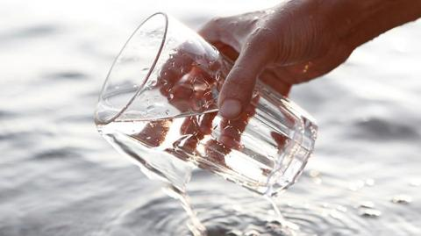
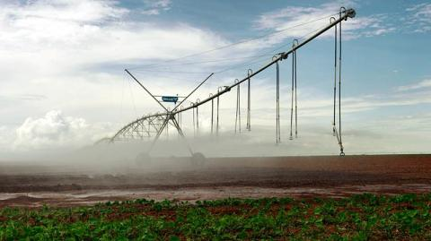
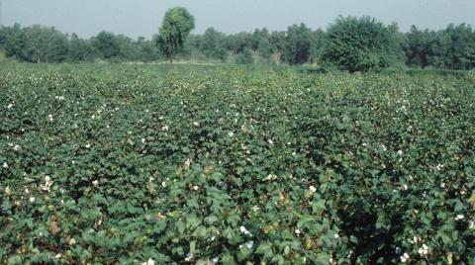
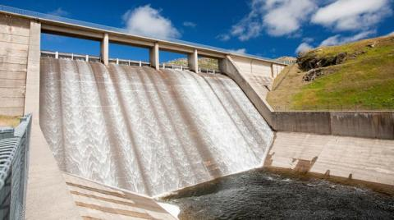
Water for people
Notes:
We need freshwater to stay alive, stay clean and water the crops we eat. We also use water to produce electricity through hydropower and in thermal power stations.
Images include:
Water to drink
Watering food crops
Producing cotton
Producing energy – a hydroelectric dam

Slide 6
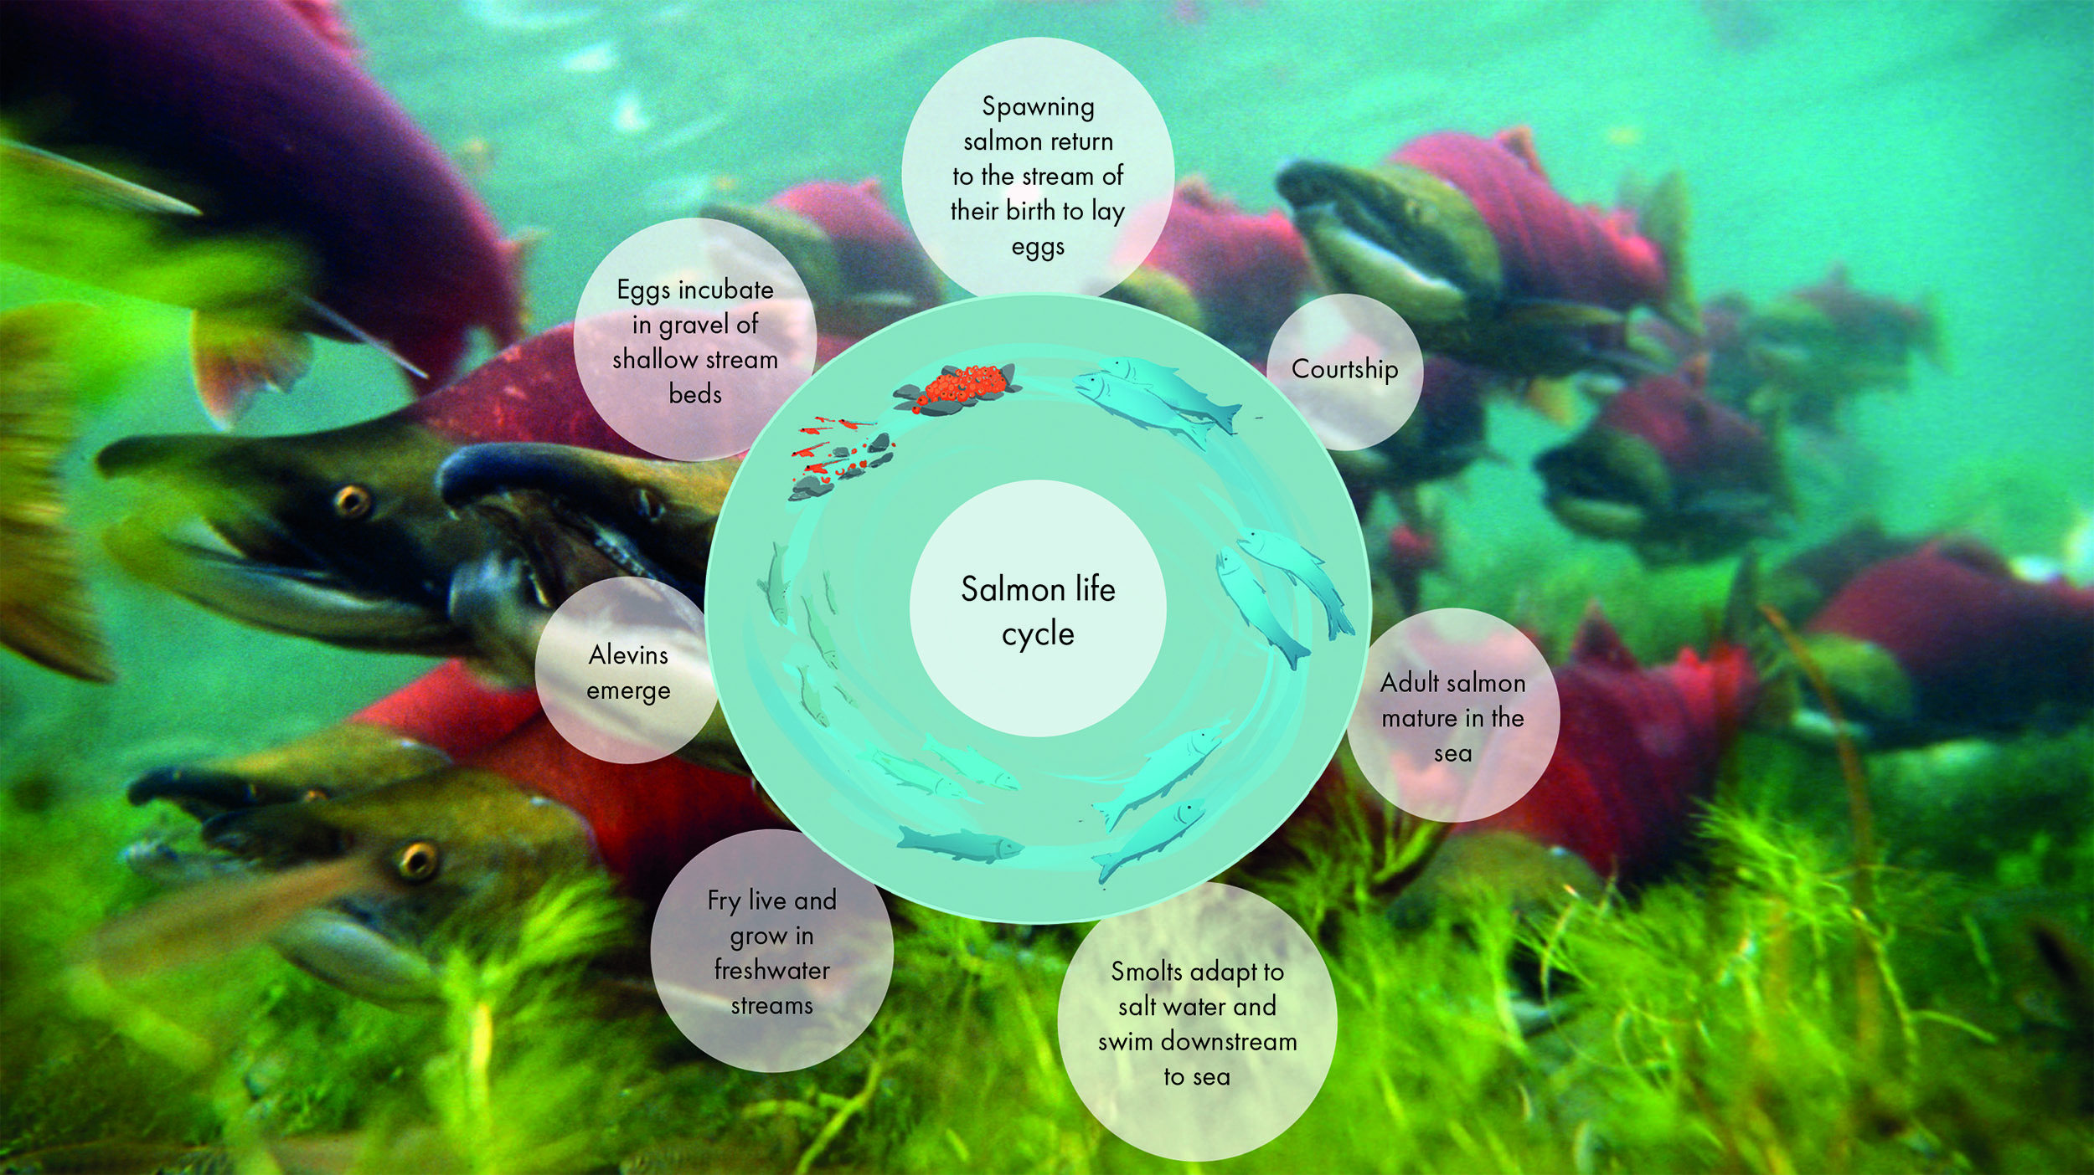
Meet the Pacific salmon
Notes:
Salmon travel for thousands of kilometres in their lifetime, spending most of their life in the ocean and returning to the river of their birth to spawn.
Salmon start life as fertilized eggs in gravel at the bottom of streams, far from the sea. After hatching, they swim downstream to the ocean where they live for many years and grow into adults. Once fully developed, their bodies change so that they can move from salt water to freshwater and they migrate to rivers and streams to lay their eggs.
When living in freshwater, salmon need a flow of clean, cool water and river features such as pools and riffles. Pools are areas of a stream or river where the water is deep, slow moving, with silt or clay on the bottom. These allow salmon to hide from predators or rest in cooler water. Riffles are areas of a stream or river where the water is shallow and fast moving, with gravel or rocks on the bottom. Salmon rely on these for laying their eggs, and the flow adds oxygen to the water.
When humans change the flow or course of a river by building dams, salmon struggle to travel up and downstream to complete their life cycle. Some dams have ‘fish ladders’ for migrating fish, but even the best of these still let fewer fish through.
Wild salmon is an important source of food and income for many people, and a vital part of the freshwater and ocean ecosystem. We risk losing them if we don’t stop interfering with the natural flow of rivers and streams.

Slide 7
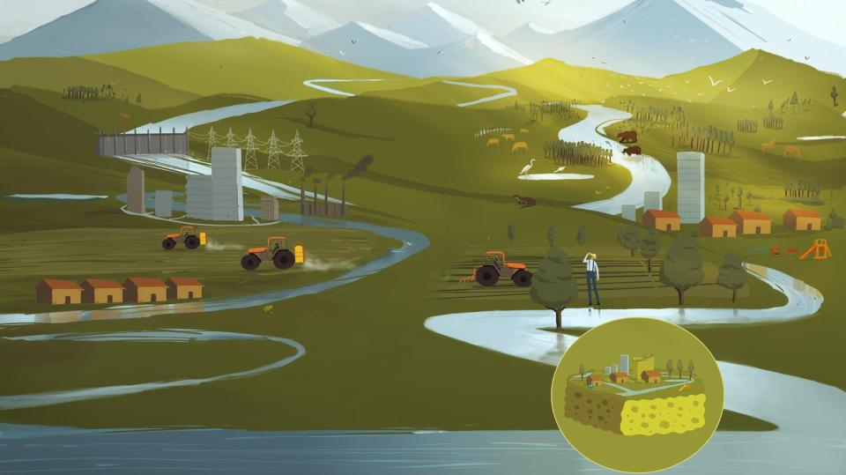
We use too much water at home and for farming. Watering crops account for 90% of the freshwater we use.
Waste from farms and cities pollutes streams, rivers and lakes.
Dams on rivers block the flow of water and prevent the movement of nutrients, sediments and wildlife.
What’s the problem?
Notes:
Decline in fish populations
Populations of freshwater species are falling faster than wildlife in any other type of habitat on our planet.
Using too much water
We are using too much water. In many places, we pump water directly from rivers or from below the ground, and take more than rainwater can replace. This means less and less water flowing downstream or underground until eventually it dries up.
Changing the flow of rivers
To collect water for cities, farms and hydropower, we build dams that stop the natural flow of rivers. Dams prevent fish from migrating upstream to spawn.
Changing the course of rivers
Concrete is used to strengthen and raise riverbanks to prevent flooding and the land along rivers is often used to build houses or as farmland. This destroys floodplain wetlands, which filter water and provide homes for wildlife and places for fish to spawn. The concrete banks can increase the flow of water and make river levels downstream rise much higher and faster. As a result, the banks often break, leading to worse floods.

Slide 8
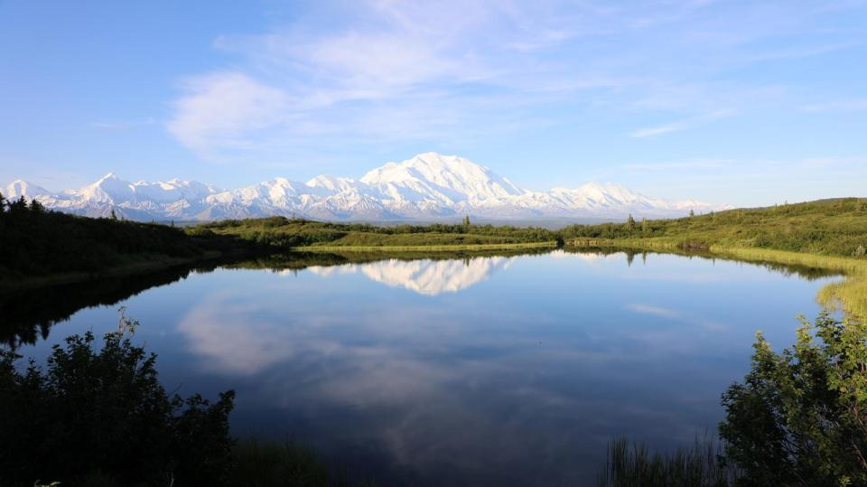
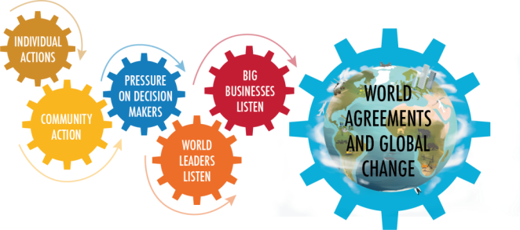
Global change
Use water more efficiently to produce food
Allow water to flow naturally in cities (e.g. green spaces and roof gardens)
Prevent pollution from farms and settlements
Design dams that allow fish to migrate
Individual actions
Save water at home and at school
Report leaks – big or small
Hold businesses to account
Ask politicians to protect rivers, streams and lakes
What can we do?
Notes:
We can all play a role in creating a more sustainable future through our own actions.
About 90% of the water we use is for crop irrigation. This can be done more efficiently and wisely through drip irrigation and other technologies that use less water.
We can remove or alter dams that cause problems by disrupting the flow of freshwater and we can think more carefully about whether, and where, to build new ones. We should explore different ways to generate renewable electricity and collect water for drinking and irrigation without blocking entire rivers.
There are things we can do at home to use less and allow more water to stay in the freshwater habitats where it is needed. We can use less water when washing, cooking, and flushing the toilet.

Slide 9
#OurPlanet
www.ourplanet.com
Notes:
Visit www.ourplanet.com for more information, classroom resources and a wealth of free videos.

