Slide 1
Keep Calm and Make Music
Weekly Wonder
Discovering the
Musical Dimensions KS2

Slide 2
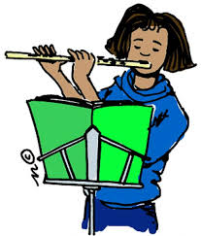
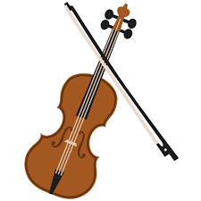
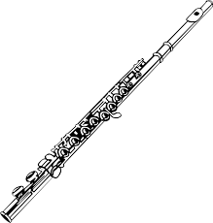
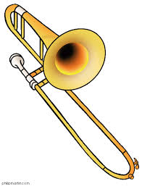
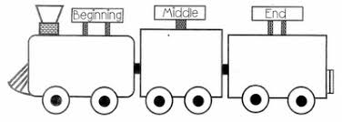
Discovering the Musical Dimensions
Pitch
Duration
Dynamics
Tempo
Texture
Structure
Timbre

Slide 3
Contents – homepage Click on the to return to this page
There are seven musical dimensions – one for every day of the week!
Which one will you discover today? Click on a dimension and off you go
Pitch – what it means and fun pitch activities
Duration – what it means and fun duration activities
Dynamics – what it means and fun dynamic activities
Tempo – what it means and fun tempo activities
Structure – what it means and fun structure activities
Texture - what it means and fun texture activities
Timbre – what it means and fun timbre activities
Quiz time
Don’t try and do them all in one go it could be a bit

Slide 4
PITCH is all about how high or low sounds are and how notes are grouped into sets called scales
Key words High, middle and low Higher and lower Scale
Click here to find out why some sounds are higher than others
Click here to find out how notes are grouped into scales

Slide 5
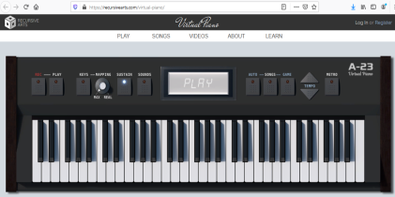
Fun pitch activities
Click here to have fun using pitched sounds to invent your own tune
Use this online virtual piano to explore high and low sounds on a keyboard
(left hand side for low and right hand side for high)
Turn the mapping dial to “real” and use your computer keyboard
to play the notes. If you click the sounds button you will be able to
choose from different types of sounds to use.
See if you can play a well known tune
e.g. Twinkle Twinkle Little Star
What other tunes can you play?

Slide 6
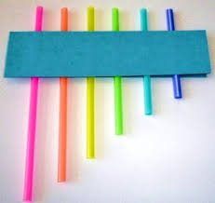
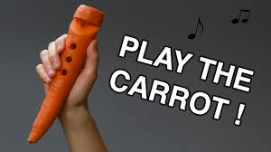
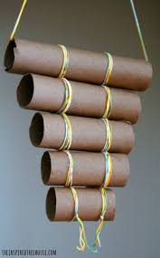
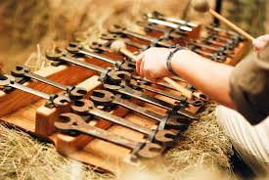
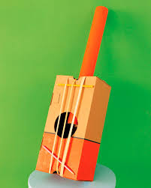
Try making an instrument that will play high and low sounds
Click here to find out
how to make a blown instrument
Other ideas for instruments that will play high and low sounds

Slide 7
DURATION is all about how long and short sounds are, beat, rhythm and metre
Key words Long and short Steady beat Rhythm pattern Metre 1 2 or 1 2 3 or 1 2 3 4
Click here to find out about the steady beat
Click here to find out about rhythm
Music beats are usually counted in groups. Metre is how many beats the music is being counted in e.g. 1 2 3 4 = 4 metre, 1 2 3 = 3 metre
and 1 2 = 2 metre
Click here to listen to a woodblock being played in 2, 3 then 4 metre at different speeds. Try clapping on beat number 1 for each example

Slide 8
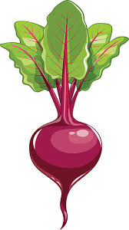
Fun duration activities
Listen to Only time will tell by Mike Oldfield Tap along to the steady beat (beep) on your thighs?
To create two possible 4 metre beet and cherry rhythm patterns click for 8 beats and then tap along to the music
e.g.
1 2 3 4 1 2 3 4
or

Slide 9
Play guess the metre – 2, 3 or 4?
Listen to the following pieces of music. Can you guess their metre? (Find the answers in the notes for this slide)
Piece 1
Piece 2
Piece 3
2 metre?
4 metre?
3 metre?
Notes:
Piece 1 – 2 metre (if you march to the music it is in 2) This music is The Imperial March (Darth Vader’s Theme) from Star Wars
Piece 2 – 4 metre - This music is an unusual version of Best Song Ever – 7 people playing one grand piano all at once
Piece 3 – 3 metre - This music is Amazing Grace performed by the legendary Elvis Presley

Slide 10
DYNAMICS is all about how loud or quiet sounds are
Key words Loud and quiet Forte and piano
Getting louder and quieter Crescendo and decrescendo
Click here to find out about forte, piano, crescendo and decrescendo
Notes:
Note – sometimes people use the word “soft” when they mean “quiet”

Slide 11
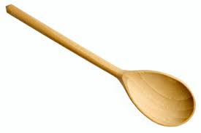
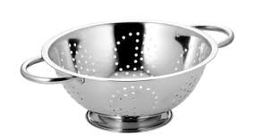
Fun dynamic activities
Listen to the March Past of the Kitchen Utensils Tiptoe around the room when the music is quiet Clap loudly on the cymbal crash Once you have got to know the music find something you can make a loud clashing sound with and join in with the cymbal
Listen to Time from the sound track of the movie Inception. Curl up in a ball on the floor for the start of the music and gradually uncurl and grow as the music crescendos - what will you do at the end as the music decrescendos?

Slide 12
TEMPO is all about how fast or slow the music is
Key words Fast and slow
Presto and largo
Getting faster and slower
Accelerando and rallantando
Click here to find out about fast and slow sounds Presto means fast and largo means slow

Slide 13
Fun tempo activities
Join in with Baby Shark How fast can you sing? Can you keep up?
Clap or dance along with this flash mob version of Zorba the Greek

Slide 14
Play the presto largo quiz
Listen to the following pieces of music. Are they presto or largo? (Find the answers in the notes for this slide)
Piece 1
Piece 2
Notes:
Piece 1 – presto. This comedy piece of music is called Number One
Piece 2 – largo. This piece is a famous jazz piece called What a Wonderful World and performed by Louis Armstrong

Slide 15
STRUCTURE is all about the order sounds happen in
Key words
Beginning, middle, ending
Call and echo, Call and response
Verse, chorus
Ternary (ABA)
Round
Theme and variations
Rondo (ABACADA)
Click here To find out about call and response, rounds and ternary form

Slide 16
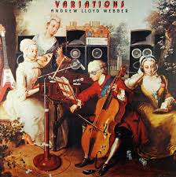
Fun structure activities
Listen to this theme and variations by Andrew Lloyd Webber
The first music you hear is the theme played on the cello – the following music is all based on this but it has been varied in some way.
Can you describe how the music has been varied? Different instruments? Different styles? Gaps?

Slide 17
TEXTURE is all about how many sounds can be heard at the same time
Key words Solo Unison Layers Ensemble
Click here to watch how layers can slowly be added to a piece of music

Slide 18
Fun texture activities
Click here and enjoy adding layers by clicking on the dots
Click here then click and drag sounds (hats, sunglasses etc) on to the performers to
add layers of sound

Slide 19
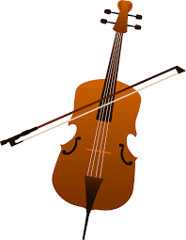
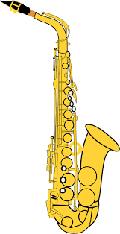
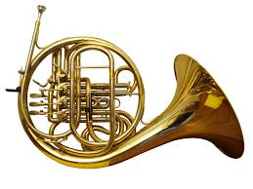
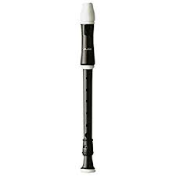
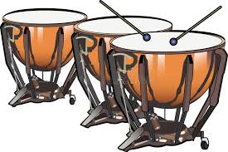
TIMBRE is all about what the sounds are like
Key words Wood Metal Skinned Instrument names
Click here To join in with the song and mime playing different instruments

Slide 20
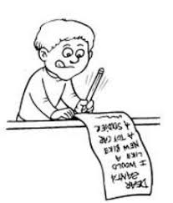
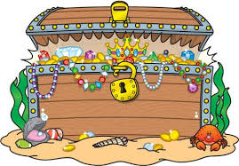
Fun timbre activities
Research which instruments belong to each of these instrument families: woodwind, brass, string and percussion.
Make a list of the instruments in each family group – which family has the most members?
Next go on a YouTube treasure hunt for examples of instruments from each of the families
Can you find a woodwind instrument ?
Can you find a brass instrument?
Can you find a stringed instrument?
Can you find a percussion instrument?
Make a poster showing all the instrument families

Slide 21
Name the dimension quiz
Look at the slides below
Can you work out which dimension each is about?

Slide 22
Key words High, middle and low
Higher and lower Scale
Notes:
Pitch

Slide 23
Key words
Long and short
Steady beat
Rhythm pattern xx xx x x
Metre 1 2 or 1 2 3 or 1 2 3 4
Notes:
Duration

Slide 24
Key words Solo Unison Layers
Ensemble
Notes:
Texture

Slide 25
Key words Wood
Metal
Skinned Instrument names
Notes:
Timbre

Slide 26
Key words
Beginning, middle, ending
Call and echo, Call and response
Verse, chorus
ABA Round
Ternary (ABA)
Theme and variations
Rondo (ABACADA)
Notes:
Structure

Slide 27
Key words
Loud and quiet
Forte and piano
Getting louder and quieter Crescendo and decrescendo
Notes:
Dynamics

Slide 28
Key words
Fast and slow
Presto and largo
Getting faster and slower
Accelerando and rallantando
Notes:
Tempo

