Slide 1
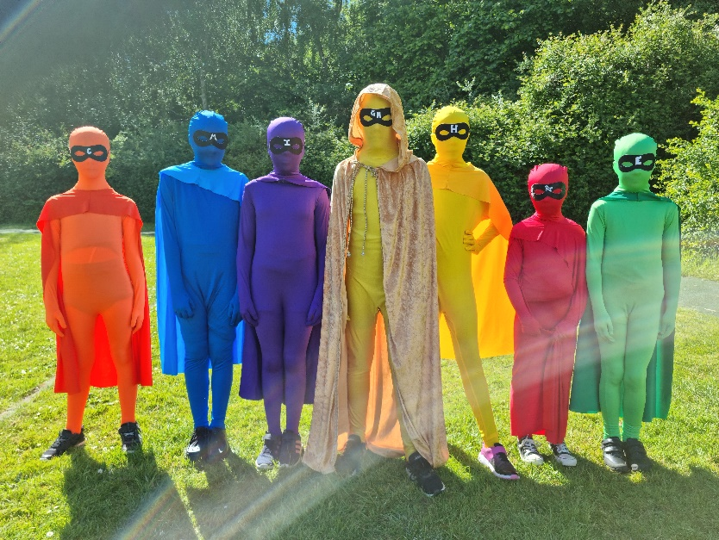
Herne Junior School Year 3 Knowing every child, Inspiring every mind, Achieving every day.

Slide 2
Year 3 Team
Ash - Mrs Harrison (Year Leader)
Mrs Longworth (LSA)
Mrs Nayton (LSA)
Fir - Mrs Scott (Teacher)
Mrs Kopeichykova (LSA)
Mrs Gould (LSA)
Oak - Mrs Mackenzie (Teacher)
Mrs Heighes (LSA)
Mrs Farleigh (LSA)

Slide 3
First week reflections!

Slide 4
All important information is in your
‘Herne Junior School – Useful Information’ booklets

Slide 5
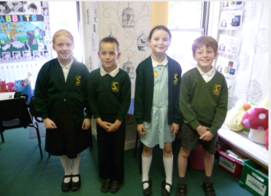
Daily Uniform
Please make sure that all uniform is fully named and regularly checked that the name is still present
Black school shoes (not trainers)
Long hair tied back
Simple stud earrings
No nail varnish
Please see the School Uniform Policy for more information.

Slide 6
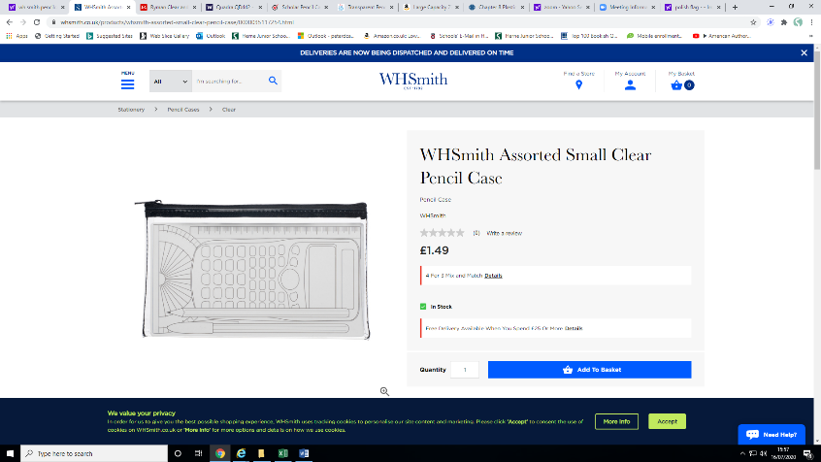
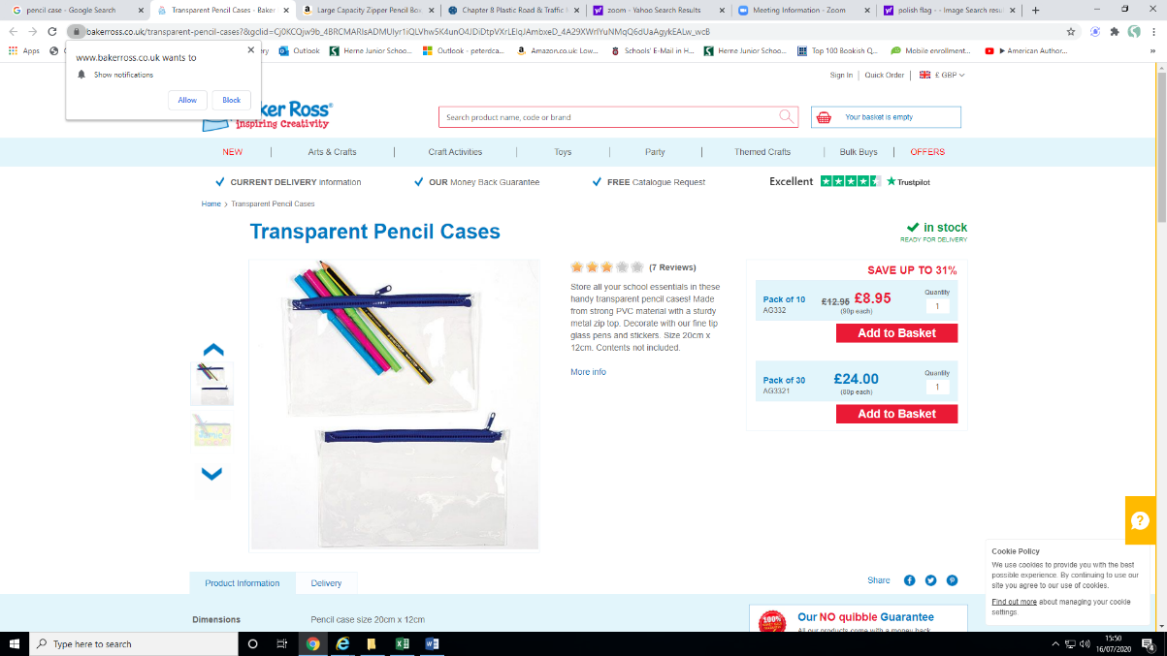
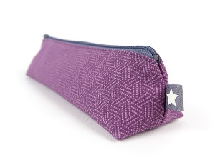
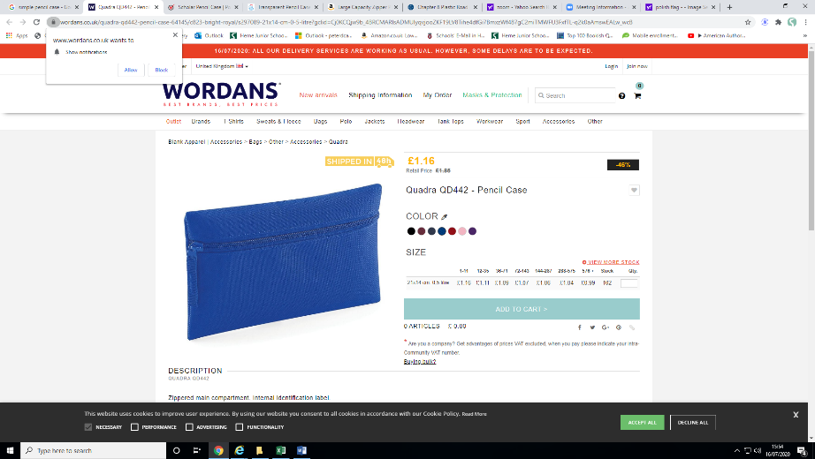
Water Bottles, Snacks & Bags
Please make sure they are all clearly named
Healthy snacks only (e.g. fruit/vegetable based). We are a nut-free school, so please check the snack first.
A small pencil case, including colour pencils (6-12 colours), small ruler (6 inch), rubber, pencil sharpener & a glue stick. Herne will provide writing pencils and pens.
Please use a suitable sized bag due to limited space in the cloakroom and classrooms. There are 90 children with school bags and the cloakroom needs to stay tidy.

Slide 7
PE days
Class teacher PE session = Wednesdays
CM Sports session = Fridays

Slide 8
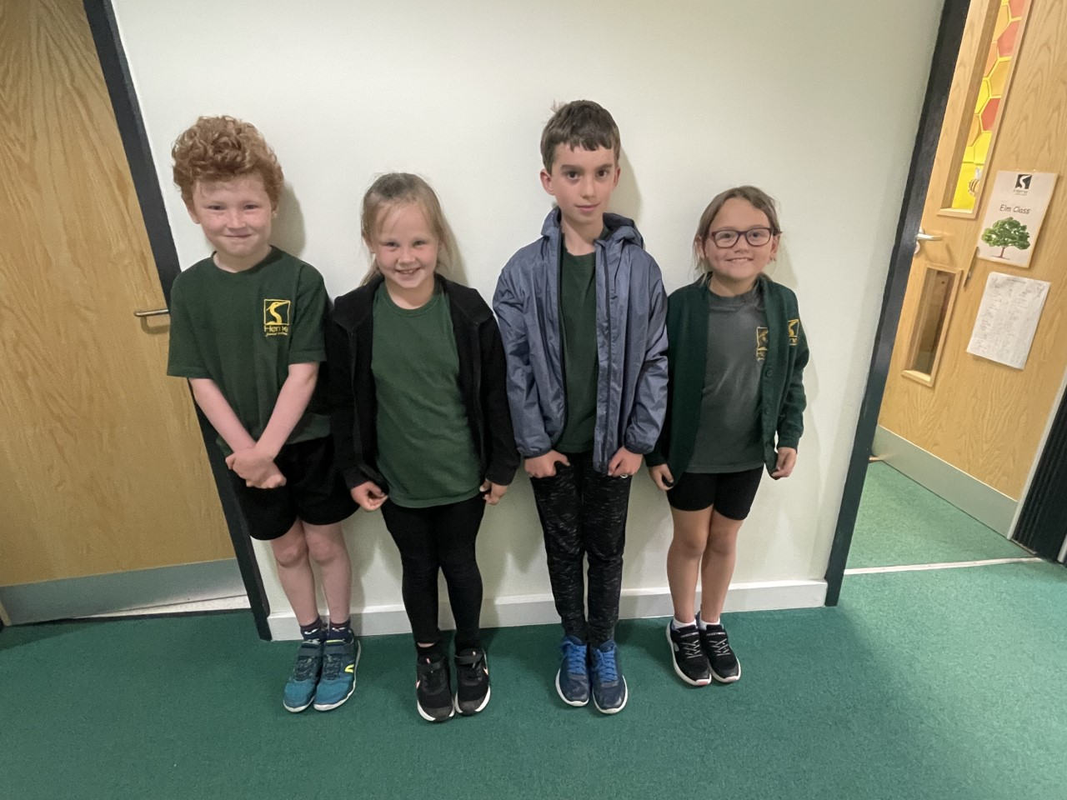
PE Uniform
Please provide your children with the following named items of uniform:
Black shorts and tracksuit bottoms
Bottle green PE top (does not need to bare the school logo)
Black zip jumper or hoodie
Black plimsolls for indoor PE
Plain trainers for outdoor PE
Long hair must be tied back and all jewellery removed or taped
Children to come to school in their PE uniforms on their PE days

Slide 9
PPA ROTATION
 |  | Autumn 1 | Autumn 2 | Spring 1 | Spring 2 | Summer 1 | Summer 2
Ash | Session 1 9.00am- 10.25am | Woodland Wonders | Woodland Wonders | French & SPAG (Laura Yarr) | French & SPAG (Laura Yarr) | CM Sports | CM Sports
 | Session 2 10.45am- 12 noon | Woodland Wonders | Woodland Wonders | CM Sports | CM Sports | French & SPAG (Laura Yarr) | French & SPAG (Laura Yarr)
Fir | Session 1 9.00am- 10.25am | CM Sports | CM Sports | Woodland Wonders | Woodland Wonders | French & SPAG (Laura Yarr) | French & SPAG (Laura Yarr)
 | Session 2 10.45am- 12 noon | French & SPAG (Laura Yarr) | French & SPAG (Laura Yarr) | Woodland Wonders | Woodland Wonders | CM Sports | CM Sports
Oak | Session 1 9.00am- 10.25am | French & SPAG (Laura Yarr) | French & SPAG (Laura Yarr) | CM Sports | CM Sports | Woodland Wonders | Woodland Wonders
 | Session 2 10.45am- 12 noon | CM Sports | CM Sports | French & SPAG (Laura Yarr) | French & SPAG (Laura Yarr) | Woodland Wonders | Woodland Wonders

Slide 10
Forest School – Woodland Wonders
Children will take part in a term of Woodland Wonders throughout the year. This will take place on a Friday morning. We will inform you when this will be in due course.
To ensure your child is comfortable, warm and prepared, please send your child to school with appropriate clothes for Forest School and the season. There is no such thing as bad weather, just poor kit. We will be outside come rain or shine!
They are likely to get muddy and/or wet so it must be separate to their school uniform.
We suggest they have a bag for their boots/wellies and a bag for their Forest School clothes. Please ensure that all items including their bag are named.
If you think any of this will be a problem, please speak to your child’s class teacher in advance of them starting Forest School. We maybe able to support with some items.

Slide 11
Kit List All of the items below are essential to ensure your child has an enjoyable time.
Autumn/Winter
Thermal leggings and top
Long sleeve trousers and top
Jumper/Fleece
Waterproof Coat and Trousers
Hat, Scarf, Gloves
Thick Socks
Wellies/Walking Boots
Spring/Summer
Long sleeve trousers and top (insect bites/nettles/ticks)
Jumper/Fleece (does get cold in the shade)
Waterproof Coat and Trousers
Sunhat
Socks
Wellies/Walking Boots
Suncream

Slide 12
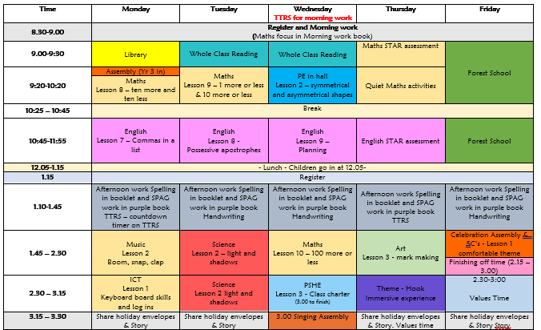
Sample Timetable

Slide 13
Permission consents & medical information
Please can you make sure you have accessed the Arbor App and updated the permission forms and medical information. We cannot do certain activities without it!
We have a trip and food tasting in the near future.

Slide 14
Toys & figit tools
Please don’t send any figit tools / toys into school with your child unless its been agreed with the class teacher as something necessary to help them settle or focus.
GOOD FOR ME
GOOD FOR YOU
GOOD FOR EVERYONE!

Slide 15
Parent Helpers
If you can spare anytime to come in and read with children, then please see the office as we would love to have you join us. No experience necessary and training will be given.

Slide 16
Reading
You all have home school link book and a reading book at your children’s level.
Library books are also available to take home.
Children are expected to read and record a minimum of 5 days each week for at least 10 minutes a time.

Slide 17
Reading
The recorded reading in the Home-School Link books are used to calculate the children’s reading miles.
The expectation is that children read at least 5 times a week.
To earn a Platinum Reader certificate, children should start recording their daily reading as soon as they are given their Home-School Link Books. We suggest reading the banded books at least 3 times per week, but you are welcome to record reading of any books you read at home too☺.
Please make sure children have their school banded book in their bags daily, as we will use these in class to assess their reading fluency and comprehension.

Slide 18
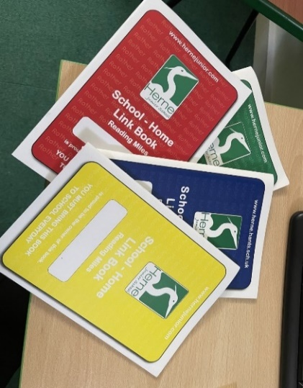
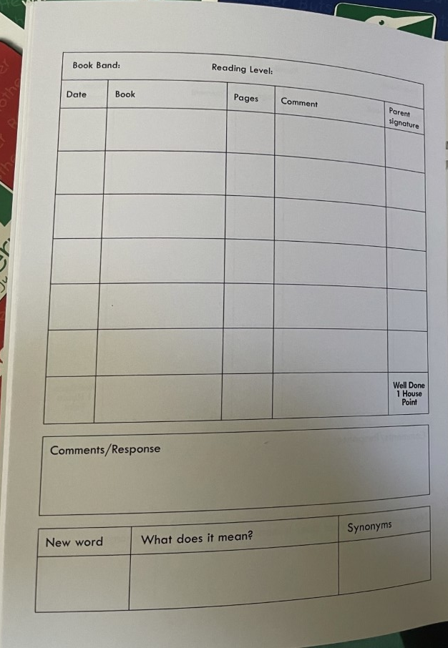
School-Home Link Books
Please make sure you record each day your child reads. We will be monitoring weekly whether the children have read the minimum of 5 days.
Each read should be approximately 10-15 minutes. We ask that children read aloud to an adult and answer a couple of questions about that snippet of the story/text. Examples of questions can be found at the back of the School-Home Link books.
School-Home Link books also form part of the communication between parents and class teachers. Pop in a quick note and we will be in touch as soon as we can☺. This helps to reduce congestion at the door at the end of the school day.

Slide 19


Homework
Set on a Friday, completed by the following Friday. All homework is digital and children have been given log-ons.
Spellings – a list is set on Spelling Shed to be practised which relates to our daily spelling practise in class. There are 5 ‘games’ required each week. Children are encouraged to then apply those spellings in different ways to ensure an understanding of their use. Evidence for this is not needed in school.
Times Tables Rock Stars (TTRS)- children are set sessions (10 garage) to be completed each week. As the children become more confident, Studio sessions will be added to this expectation, starting in the Spring term.
All homework will be monitored online and will be used to assess progress.

Slide 20
We have a variety of interventions that we offer the children to boost them in areas where we feel they need help developing. This might be: - Social and emotional support - Phonics / writing - Maths support - Handwriting support We put them into these groups and will notify you if we have done so.
Interventions

Slide 21
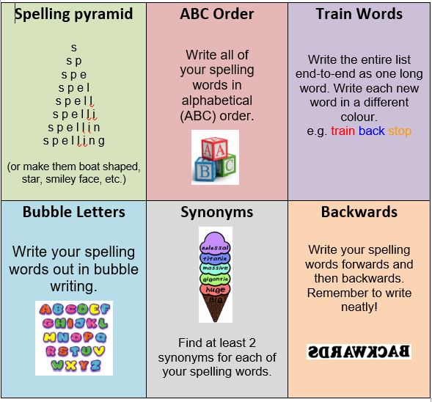
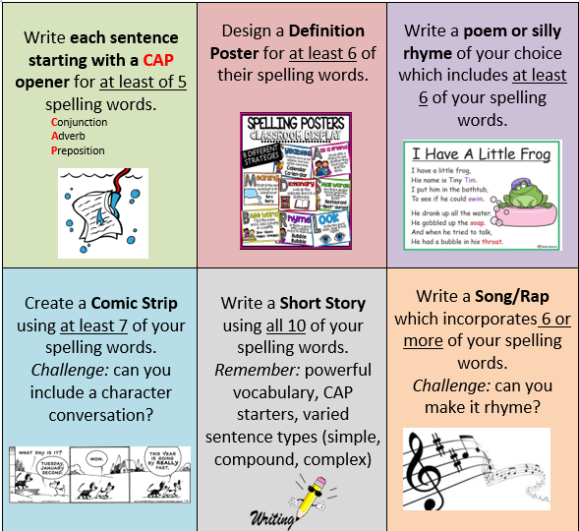
Optional methods for practising and embedding spellings ☺.
These can be found on the school website.
(Children tab - Homework (Y3))
https://www.herne.hants.sch.uk/page/?title=Homework+%28Year+3%29&pid=147
Information relates to current Year 3’s and will be updated before September.

Slide 22
Special Values Time
Tickets are earned when the children reach the top of the behaviour board and tickets are then randomly selected.
Children to receive special recognition and get a reward. An extra play on the adventure equipment or House Points – your choice!
House Points
Children earn house points throughout the year in recognition of hard work, behaviour and just being amazing! These house points equate to certificates, and once all 6 Harmony Certifications have been achieved, the children receive a Gold Harmony wrist band and work towards their Gold, Platinum and Diamond certificates.

Slide 23






Our exciting Year 3 curriculum
Autumn - Environmental Detectives
When researching our local area and our way of living, we look at how we can support our environment and live more sustainably. Through looking at world maps, exploring the continents and significant countries, we identify similarities and differences to our home town of Petersfield and a village within the Amazon Rainforest.
Spring- A Journey Through the Ages
Let’s head back in time to the years before written records! Starting in the Stone Age, we learn about significant achievements and legacies that have helped shaped our lives today.
Healthy Heroes
It’s time to put on our capes and help the world (or just ourselves!) become Healthy Heroes. We delve deep into the importance of diet and exercise and how these help us to lead an active, healthy lifestyle.
Summer- Rocking Romans
Continuing our historical learning, we place the Romans in history and develop our chronological awareness. Who were the Romans? When and why did they invade? How are our lives different today because of them?

Slide 24



Whole Class Reading
Throughout the year, we will read and explore a variety of engaging, quality texts.
To ease the children into the year and teach key comprehension skills, we will be starting the Autumn term with Phonics recap and Reading Explorers.
For our first book, bringing a link to our theme Environmental Detectives, we will be reading Lob, by Linda Newbery. We only have a set of 30 in school, so if you would like to purchase your own copy before we start this book, it will allow your child to follow along with ease and it would be greatly appreciated.
Spring text- Matilda, by Roald Dahl
Summer text- The Leopard in the Golden Cage,
by Julia Edwards

Slide 25
Theme & Planned Trips
Environmental Detectives (Gilbert White’s House)
A Journey Through the Ages (The Heath & museum)
Healthy Heroes (Healthy Hero Day- dress up)
Rocking Romans (Rainbow Theatre)
These trips are only possible with your contributions so please pay as much as possible for each trip/event.

Slide 26
Parent Helpers
Readers
Art and DT days
Trips
DBS forms required (contact the office for further details)
Please approach your class teacher with your availability
Vital information sheet- please see us even if stated on this form
Any and all help is extremely appreciated, so please let your class teacher know if you are available to help.

Slide 27
Questions?
For any school-based questions, please contact the school office on admin@hernejunior.com or 01730263746.
These emails and calls will be forwarded to the class teacher and we will get back to you as soon as we can.
Thank you ☺

